Slide 1

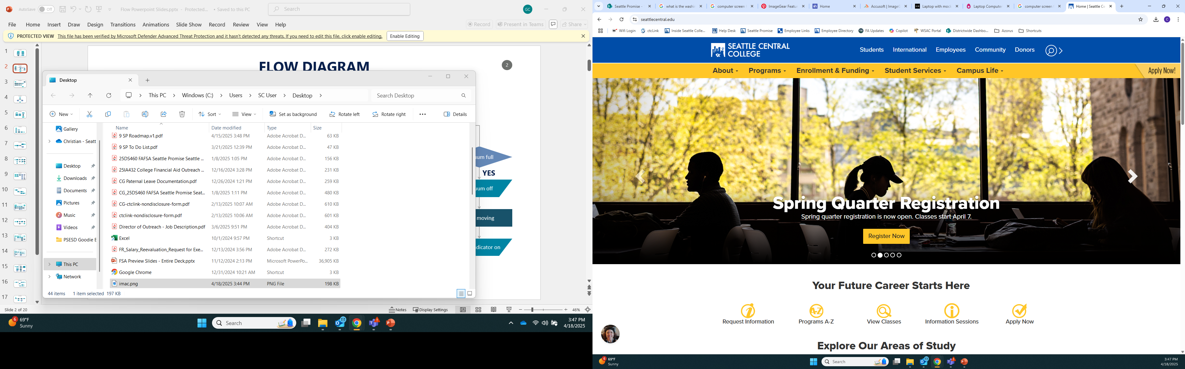
Accessing Your To-Do Tasks in CtcLink
Step 1: (if using a lab at Seattle Colleges, if not go to Step 2)
Log in to your Computer
Username: scguestlab
Password: Occur2instant@done
Step 2:
Open browser and navigate to
seattlecentral.edu
northseattle.edu
southseattle.edu
Notes:
Mult-factor authentication resource: https://itservices.seattlecolleges.edu/ctclink.
PDF with screenshots: ctcLink MFA setup instructions

Slide 2
Accessing CtcLink
Step 3: Select “Students” in top menu
Notes:
Mult-factor authentication resource: https://itservices.seattlecolleges.edu/ctclink.
PDF with screenshots: ctcLink MFA setup instructions

Slide 3
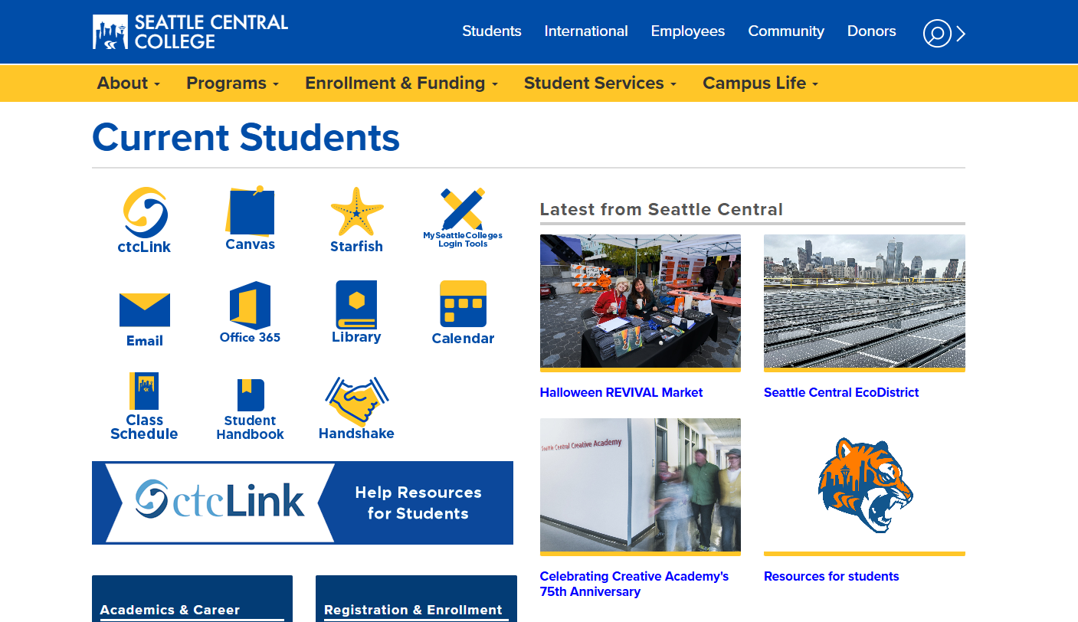
Accessing CtcLink
Step 4: Select ctcLink icon
Notes:
Use dummy account to walk students through the process on the screen
Dummy Account info:
https://scedu.sharepoint.com/:p:/r/sites/SeattlePromise/Shared%20Documents/Readiness%20Academy/2024/Planning/OS%20Advising%20Training%20-%20Reg%20101,%20How%20to%20Register.pptx?d=w0b48e50586bf4c18b15e5ff4f5f002dd&csf=1&web=1&e=3yO4lN&nav=eyJzSWQiOjM0OCwiY0lkIjoyNzYxNzkxMTc2fQ

Slide 4
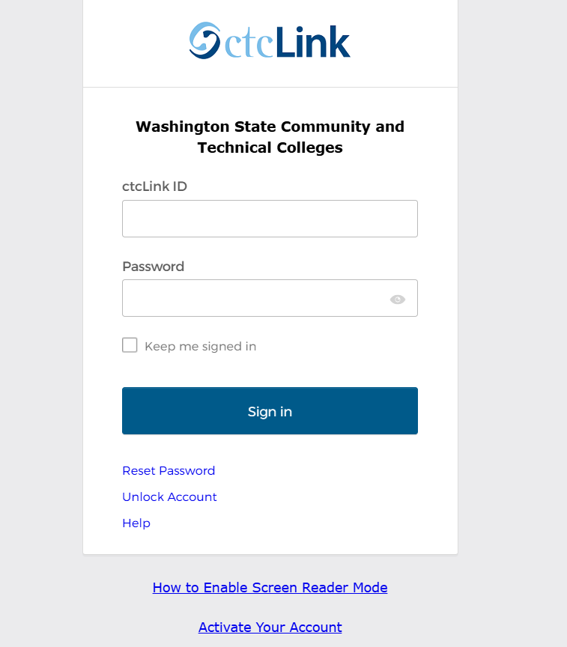
Accessing CtcLink
Login to ctcLink account and go to your student homepage
Notes:
Use dummy account to walk students through the process on the screen
South:
Fake Student #1 ​
1. EMPL ID = XX064CS01 ​
2. Password = SouthSeattle@064 ​
3. Name = South Seattle College ​
​
Fake Student #2 ​
1. EMPL ID = XX064CS02 ​
2. Password = SouthSeattle@064 ​
3. Name = South Seattle College ​
​
Fake Student #3 ​
1. EMPL ID = XX064CS03 ​
2. Password = SouthSeattle@064 ​
3. Name = South Seattle College
North
Fake Student #1​
1. EMPL ID = XX063CS01 ​
2. Password = NorthSeattle@063 ​
3. Name = North Seattle College (“Nikki”)​
​
Fake Student #2 ​
1. EMPL ID = XX063CS02 ​
2. Password = NorthSeattle@063 ​
3. Name = North Seattle College ​
​
Fake Student #3 ​
1. EMPL ID = XX063CS03 ​
2. Password = NorthSeattle@063 ​
3. Name = North Seattle College
Central:
Fake Student #1 ​
1. EMPL ID = XX062CS01 ​
2. Password = SeattleCentral@062 ​
3. Name = Seattle Central College ​
​
Fake Student #2 ​
1. EMPL ID = XX062CS02 ​
2. Password = SeattleCentral@062 ​
3. Name = Seattle Central College ​
​
Fake Student #3 ​
1. EMPL ID = XX062CS03 ​
2. Password = SeattleCentral@062 ​
3. Name = Seattle Central College
Dummy Account info:
https://scedu.sharepoint.com/:p:/r/sites/SeattlePromise/Shared%20Documents/Readiness%20Academy/2024/Planning/OS%20Advising%20Training%20-%20Reg%20101,%20How%20to%20Register.pptx?d=w0b48e50586bf4c18b15e5ff4f5f002dd&csf=1&web=1&e=3yO4lN&nav=eyJzSWQiOjM0OCwiY0lkIjoyNzYxNzkxMTc2fQ

Slide 5
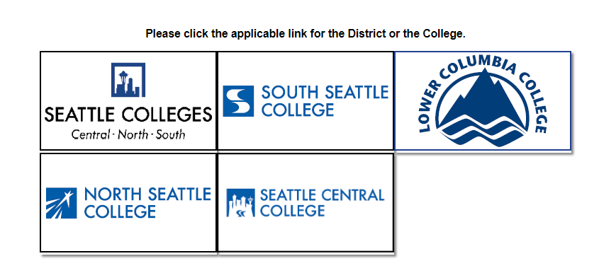
Accessing CtcLink
Select your
college
Notes:
Use dummy account to walk students through the process on the screen
Dummy Account info:
https://scedu.sharepoint.com/:p:/r/sites/SeattlePromise/Shared%20Documents/Readiness%20Academy/2024/Planning/OS%20Advising%20Training%20-%20Reg%20101,%20How%20to%20Register.pptx?d=w0b48e50586bf4c18b15e5ff4f5f002dd&csf=1&web=1&e=3yO4lN&nav=eyJzSWQiOjM0OCwiY0lkIjoyNzYxNzkxMTc2fQ

Slide 6
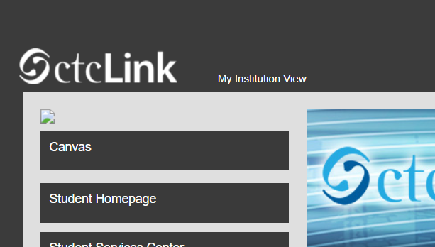
Accessing CtcLink
Select “Student
Homepage”
Notes:
Use dummy account to walk students through the process on the screen
Dummy Account info:
https://scedu.sharepoint.com/:p:/r/sites/SeattlePromise/Shared%20Documents/Readiness%20Academy/2024/Planning/OS%20Advising%20Training%20-%20Reg%20101,%20How%20to%20Register.pptx?d=w0b48e50586bf4c18b15e5ff4f5f002dd&csf=1&web=1&e=3yO4lN&nav=eyJzSWQiOjM0OCwiY0lkIjoyNzYxNzkxMTc2fQ

Slide 7
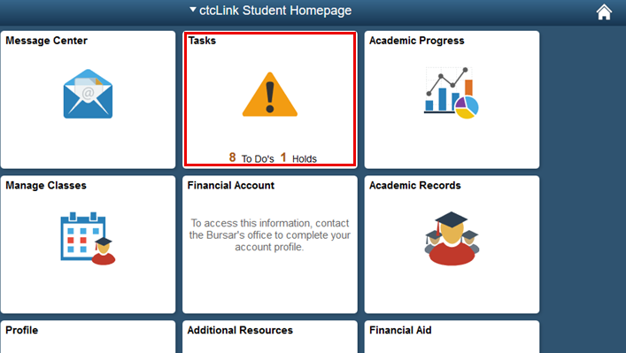
Accessing CtcLink
Select “Tasks”
Notes:
Use dummy account to walk students through the process on the screen
Dummy Account info:
https://scedu.sharepoint.com/:p:/r/sites/SeattlePromise/Shared%20Documents/Readiness%20Academy/2024/Planning/OS%20Advising%20Training%20-%20Reg%20101,%20How%20to%20Register.pptx?d=w0b48e50586bf4c18b15e5ff4f5f002dd&csf=1&web=1&e=3yO4lN&nav=eyJzSWQiOjM0OCwiY0lkIjoyNzYxNzkxMTc2fQ

Slide 8
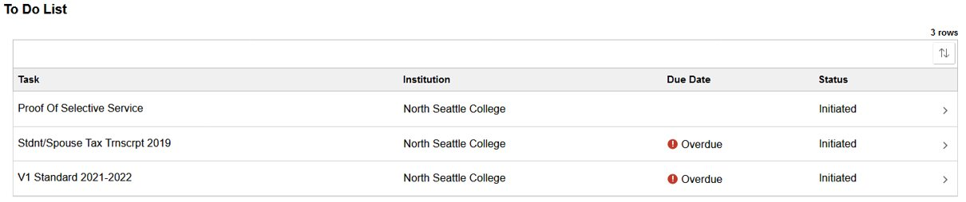
Your To Do List Page
This will take you to the To Do List page, select a Task to view its details.
Notes:
Back-ups:
NSC:
User: Northguest
Password: Vasanta2023!!
South & Central:
User:
Password:

Slide 9
Your To Do List Page
This will take you to the To Do List page, select a Task to view its details.
Task Column
Lists name of each "To-Do" item to complete
Notes:
Back-ups:
NSC:
User: Northguest
Password: Vasanta2023!!
South & Central:
User:
Password:

Slide 10
Your To Do List Page
This will take you to the To Do List page, select a Task to view its details.
Institution
School the task is connected to
Notes:
Back-ups:
NSC:
User: Northguest
Password: Vasanta2023!!
South & Central:
User:
Password:

Slide 11
Your To Do List Page
This will take you to the To Do List page, select a Task to view its details.
Due Date
Recommended deadline to complete task
Notes:
Back-ups:
NSC:
User: Northguest
Password: Vasanta2023!!
South & Central:
User:
Password:

Slide 12
Your To Do List Page
This will take you to the To Do List page, select a Task to view its details.
Status
If the item has been successfully submitted
Notes:
Back-ups:
NSC:
User: Northguest
Password: Vasanta2023!!
South & Central:
User:
Password:

Slide 13
Your To Do List Page
All tasks must be complete by July 31st
Processing times may result in tasks not being present.
Check back regularly for updates.
Notes:
Back-ups:
NSC:
User: Northguest
Password: Vasanta2023!!
South & Central:
User:
Password:

Slide 14
How do I know if my task has been completed?
Status: If the item has been successfully submitted
Status | Definition | Action from Student
Initiated | Item must be submitted | Follow instructions in task details to submit item requested
Received | Item is submitted and processing | Check email and ctcLink for status updates
Returned | Item must be resubmitted due to incomplete, error, etc. | Follow instructions to resubmit item with corrections made. Contact financial aid if you are not sure what correction is needed
Completed | Item is submitted and processed to student file | Check email for Financial Aid processing updates
Cancelled | Item is no longer needed | No action needed
Waived | Item has been waived, information is updated or no longer required | No action needed

