Slide 1
Seattle Colleges Winter Quarter Budget Town Hall
Thursday, February 6, 2025 via Zoom
Dr. Rosie Rimando-Chareunsap, Chancellor Dr. Rachel Solemsaas, Acting Vice Chancellor of Finance & President of North
Joined by Dr. Chantae Recasner, Interim President, Central Dr. Monica Brown, President, South

Slide 2
Today’s Town Hall Plan
Leadership Update
Understanding the District Context
Districtwide Budget numbers
How we will respond
Notes:
Rosie

Slide 3
Leadership Update
Central President
Dr. Chantae Recasner (VPI) Has been appointed as Interim President. Chris Sullivan is serving as Acting VPI at Central.
Vice Chancellor of Finance and Operations
Dr. Rachel Solemsaas will continue to serve in dual roles for the time being while we strengthen our budget environment and assess readiness for an open CFO search.
Notes:
Rosie

Slide 4
Understanding our District Context

Slide 5
How do we relate as a district?
Established as a multi-college district in 1967 by WA State Legislative Action.
We have evolved significantly from the past. We will continue to evolve to better serve our students.
We are much stronger as a collective force.
Notes:
As we have sought to solve systemic challenges, we have come together by choice (e.g. Guided Pathways redesign, placement strategy revisions, centralized IT and HR,
Use UW comparison

Slide 6
The colleges’ primary functions are to teach and support students.
District’s primary functions are to enable the infrastructure and resources that support faculty and staff that teach and support students.
Notes:
As we have sought to solve systemic challenges, we have come together by choice (e.g. Guided Pathways redesign, placement strategy revisions, centralized IT and HR,

Slide 7
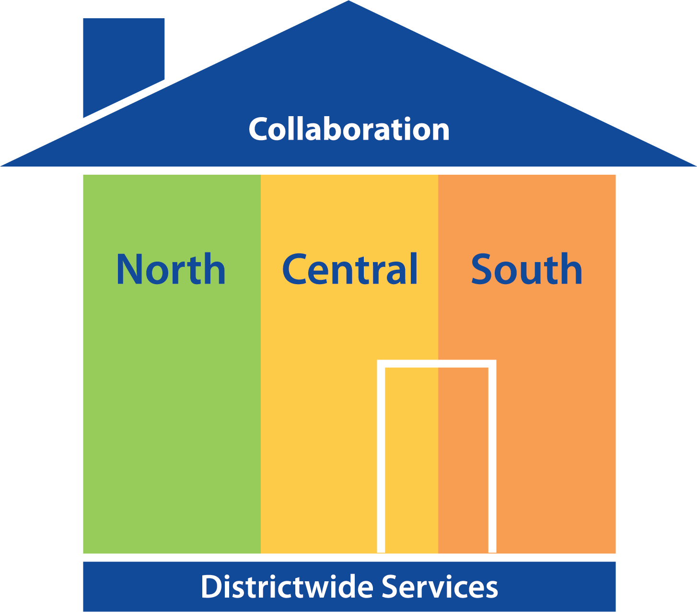
What are Districtwide Services?
Functions that provide infrastructure that enable college-based direct instruction or service to students
Systems that support employees districtwide
Functions to serve districtwide reporting and compliance requirements
Specially-funded programs that serve students districtwide
Functions that connect, support or develop programming and resource districtwide
Notes:
Functions that provide infrastructure that enable college-based direct instruction or service to students
Like Finance, IT, Library Technology, ctcLink, Starfish, Financial Aid processing, eLearning
Systems that support employees districtwide
Like IT, HR, Payroll, Communications and Web Services
Functions to serve districtwide reporting and compliance requirements
SEM, Compliance, Workforce Education
Specially-funded programs that serve students districtwide
International and Seattle promise
Functions that connect, support or develop programming and resources districtwide
Foundation, Communications, Strategic Enrollment Management and Strategic planning, student recruitment planning, Title III

Slide 8
What are Districtwide Services?
Accessibility, Community and Opportunity
Advancement/Seattle Colleges Foundation
Chancellor’s Office & Board of Trustees
Communications/Public Relations
Compliance
eLearning
Enrollment Management
Faculty Development (with AFT)
Finance & Accounting
Human Resources
IT (incl. Library Tech., ctcLink, Starfish, etc.)
International Programs
Payroll & Benefits
Seattle Promise
Student Recruitment (districtwide)
Title III districtwide SIP grant
Web Services
Workforce Education
*other distinct functions are included within some of these units
Notes:
It is very important to note that almost all of these functions are necessary at any single college in our system. But like Spokane and Pierce, we are a district, so a variety of functions are positioned centrally.
It is important to understand our fundamental interconnectedness. District services are not people siloed away at Siegal. They are our colleagues across all the colleges, sitting in workspaces next door to you, participating on college committees, celebrating retirements and baby showers.
Once again, we have evolved immensely compared to 10, 20 years ago. I should know, this week marks my 25th anniversary in the Seattle Colleges.

Slide 9
How are we funded?

Slide 10
How we are funded – A patchwork
State allocation (based on FTEs), student achievement incentives and earmarks/provisos
Locally generated revenues (not from state) i.e. Running Start and International tuition
Auxiliary revenue (auxiliary functions provide additional, usually non-instruction based revenues such as rentals or services)
Relatively small amounts from various other sources
Learn more detail on the recently updated Budget Website

Slide 11
How are we funded The Big Picture?
At a fundamental level, we are grossly underfunded for the services and instruction we are expected to provide.
This leaves us to imperfectly weave a patchwork of revenue sources for an increasingly complex and costly endeavor, with slim margins to absorb changes to our expenses or enrollments.
Notes:
UW Comparison
33K undergrads compared to our 30K headcount (IPEDs)
$9 BILLION budget, compared t our $199 million (but we don’t have athletics, graduate schools or medical schools)
$5,5BILLIon endowment, and we are raising our first $60Million
https://finance.uw.edu/treasury/cef2024

Slide 12
 | 2014 | 2018 | 2019 | 2020 | 2021** | 2022 | 2023 | 2024 - Unaudited
FTEs | 19,263 | 17,599 | 16,545 | 15,525 | 13,511 | 12,075 | 12,442 | 13,452
% Change (14vs24) | -30.17% | -8.64% | -5.99% | -6.17% | -12.97% | -10.63% | 3.04% | 8.12%
Enrollment Trends
Headcounts | 45,965 | 44,824 | 42,805 | 40,137 | 31,813 | 28,971 | 30,763 | 32,800
% Change (14vs24) | -43.20% | -7.51% | -2.95% | 11.89% | 14.91% | 6.57% | 6.37% | 9.46%

Slide 13
Continuing Path to Financial Stability & Sustainability
Adopt Clear Fiscal Goals
Live within our Means (operating budget and self-support budgets)
Maintain prudent level of reserves
Invest in the Future
Strengthen Budget Controls
Assure Data accuracy & integrity
Review budget roles and provide training

Slide 14
Board Directives
Live within our Means
Approved a balanced spending plans for all funds
Monitor spending plan through periodic budget versus actual reports to update budget assumptions
Maintain Prudent Level of Reserves
Set up contingency, operating, & capital reserves
Approved reserve plans, including ways to replenish fund if funds are used or targets are not met
Invest in the Future
Support for foundation workplans
Support for grants and partnerships

Slide 15
Budget Developments Since Nov 2024
Factors to consider
FY 24 Deficit means FY 25 Modifications (reductions)
State OFM error impact to FY 25 and FY 26
State's looming deficit
Fiscal impact of AFT Faculty and AFT Pro negotiations
Credibility of Data
Detailed analysis of State Allocation (with crosstab to dept expenditure budget)
Tuition Revenue modeling and projections (historical trend analysis and FTE projections)
Accounting for Interfund Transfers, including International Program overhead costs
Fund (cash) balance analysis by department
Position Control systems

Slide 16
FY 24 Recap
Seattle Colleges District closed the FY 24 with a net deficit of $12.5 16M or 8% of total expenditures.
The deficit resulted from:
Overestimated tuition revenues
Implementation of post pandemic staffing plans
Increased expenditures in personnel (salary increases), utilities, etc.
Remedies:
Update FY25 budget assumptions
Strengthen budgetary controls and reporting
Strengthen tuition revenue projections based on SEM approaches
Use cash reserves to cover deficit
Notes:
Suggested talking points:
*All three colleges overestimated state tuition. However, the colleges also received additional international and running start revenues
*additional personnel especially for the district is implementation of staffing needed post pandemic in HR, Budget, etc.
Remedies
*The deficit will be covered by our cash reserves and despite this, we are still maintaining a healthy and prudent level of reserves. In addition to meeting board mandated reserves, our plan continues to exceed that plus ensuring dedicated fund balances are maintained plus appropriate investment in our future. A detailed cash balance report will be presented to the Board in Jan 2025
*The outcome of FY 24 closing also necessitates an update to our budget assumptions for FY 2025. In addition to updating assumptions for tuition revenues, adjustments to the state allocation like OFM error would likely result to right sizing our FY 25 budget. We plan to bring this to the board in December 2025
*Finally, work is underway to strengthen budgetary controls, including timely reporting and monitoring of personnel costs and other expenditures.

Slide 17
Fund/Dept#/Dept Description | 2022 | 2023 | 2024 | 2025
CASH RESERVE Beginning Balances | 97,570,190.96 | 102,863,761.63 | 101,286,895.99 | 85,708,151.23
Difference Increase (Decrease) |  | 5,293,570.67 | (1,576,865.64) | (15,578,744.76)
 |  | 5.43% | -1.53% | -15.38%

Slide 18
 | FY 24 |  |  | FY 25
 | Dedicated | Unrestricted | Total | Dedicated | Unrestricted | Total
CASH RESERVE Balances | 69,336,806 | 31,950,090 | 101,286,896 | 52,325,368 | 33,382,783 | 85,708,151
Difference Increase (Decrease) |  |  |  | (17,011,438) | 1,432,693 | (15,578,745)
 |  |  |  | -24.53% | 4.48% | -15.38%

Slide 19
FY 25 Modified Budget Status
FY 25 Projected Budget Deficit is projected at $30M. This includes FY 24 deficits plus OFM error
Plans to mitigate this includes
Freeze savings estimated at $9.1M
Redirecting personnel costs to other funds
Use of Fund (Cash) Balance $21M

Slide 21
Seattle Colleges Unrestricted Cash Reserve
Board of Trustee's Policy on Reserves:
Seattle College District Policy #608 - District Reserve
Unrestricted Cash Reserve Balance | $33,382,783
Board Policy Reserve Requirement | 9,936,566
5-10% of aggregate total of annual expenditure budget (using 5% here)
Cash Reserve Balance less Dedicated Reserves and BOT Reserve | $23,446,217
Less: FY 2025 Anticipated Deficits (net of vacancy savings) | 21,046,523
Projected Ending Cash Reserve Balance FY 25 | $2,399,694

Slide 22
Budget Status FY 26 & Beyond
 | North | Central | South | Siegel/District | Total
FY 25 Anticipated Deficit | (3,946,151) | (8,948,861) | (3,028,261) | (14,256,376) | (30,179,649)
FY 26 State Allocation $1B Deficit | (792,000) | (1,003,200) | (844,800) | (660,000) | (3,300,000)
Anticipated CBA fiscal impact
International Revenue Adj | (683,280) | (1,821,616) | (442,002) | (983,360) | (3,930,258)
District Transfer Adj | (232,498) | (1,703,418) | 264,777 | 1,671,139 | -
New CTCLink Fee
FY 26 tuition revenues rate @3.3% | 436,109 | 571,822 | 367,358 | 401,529 | 1,776,818
FY 26 tuition revenues FTEs @4% | 528,617 | 693,117 | 445,282 | 486,701 | 2,153,718
Net Anticipated Deficit | (4,689,203) | (12,212,156) | (3,237,645) | (13,340,367) | (33,479,371)
 | -8.70% | -16.11% | -6.09% | -33.70% | -16.76%

Slide 23
How are we responding?

Slide 24
Current/Recent Activity for FY25 (2024-2025)
Local work:
November – January: Focus on data integrity and ensuring we get our figures right, and double/triple check them
Spending freeze for FY 25
Cash balances analysis to identify funds to cover what the spending freeze cannot recuperate
Broader context work:
Advocacy with legislators around adequate funding
Advocacy with federal leaders right now in Washington DC

Slide 25
How we will meet a $30M challenge?
Increase Revenues
1
Improve and Strengthen Systems
3
Manage and Reduce Expenses
2

Slide 26
Strategies to Explore
Increasing Revenues
Reducing Expenditures
Strengthening Budget Systems
Explore CTCLink based fees and other lab fees
Expand partnerships
Monetized Assets
Staffing plan review
Program & Services review
Reduce Operating cost, including maximizing use of facility spaces
Review cost reimbursables
Set up check n balances and audit trail to financial reporting
Financial Modeling for tuition and costs
Predictable model to cover Core District services
Se policy reserves for contingency, capital and contingency
Predictable monitoring of budget versus actual reports for all funds

Slide 27
Other impacts are preparing for
The OFM Error, potential impact $2.7M (of $28M to system)
Projected state revenue shortfall, potential impact of $3.3M (for every $B cut from state revenue)
Commitments to CBAs
Replenishing depleted cash reserves (building back the savings account)
Enrollment growth: potential for strengthened revenues, with strategic planning

Slide 28
The federal context
As if our local and state challenges were not enough…

Slide 29
We continue to monitor federal actions that may impact:
Federal financial aid
Federal grants such as TRiO, Title III, AANAPISI, NSF and others that directly serve many students
The potential impact or “chill” on international enrollments coming to the US
The immigration prerogative that will drive students away from enrolling in higher education
The environment that has nurtured and supported our work in Diversity, Equity and Inclusion for decades, and the resources that have been invested from public and private entities

Slide 30
What to expect moving forward
Your three presidents and chancellor will continue to work hand-in-hand
Weekly Budget Update emails on Thursdays
We will share updates, developments and resources on a weekly basis
Regular districtwide Budget Town Halls
Ongoing college Forums, Town Halls & Conversations
Engagement with shared governance bodies: College Councils, e.g.
Strategies may not be identical across the organization. We seek to honor the diversity of approaches and needs across the district’s entities, and build toward a collectively stronger fiscal environment.

Slide 31
Questions and Discussion

