Slide 1
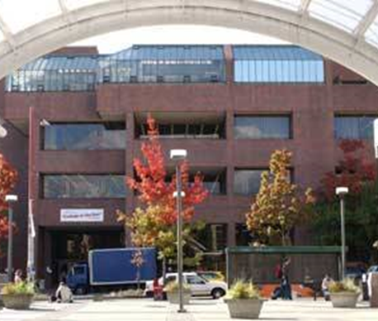
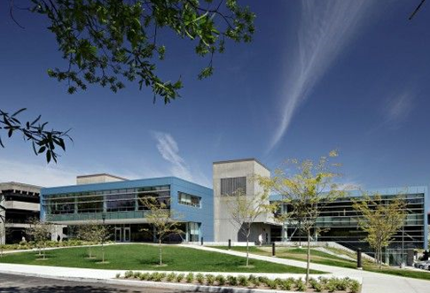
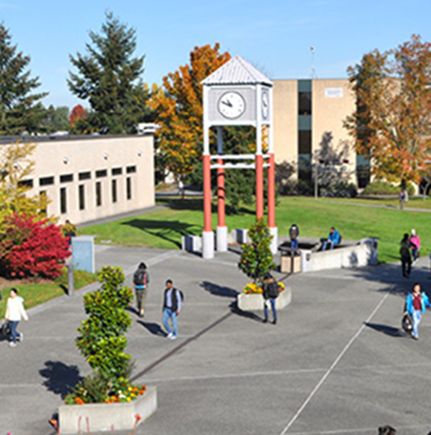


Seattle Colleges
Budget Proposal
Fiscal Year 2017-18
Shouan Pan, Chancellor
Kurt Buttleman, Vice Chancellor for Finance & Information Technology

Slide 2
Timeline
Engage the Board of Trustees in setting policy directions for budget development and financial management (November)
Develop organizational plans and strategies that reflect strategic priorities (January – February)
Develop a preliminary budget (March – April)
Communicate the preliminary budgets to key stakeholders (May)
Budget approval and adoption (June)

Slide 3
State of Washington Budget
Governor
  Net result = Seattle Colleges reduction of approximately $2,000,000
  No tuition increase
  ALL employee COLAs = 6%
Senate
  Net result = Seattle Colleges reduction of approximately $3,000,000
  Tuition increase of 2.0% in FY18 & 2.2% in FY19
  Faculty COLAs of 5.0%
  ALL other employees $500 increase to base salary
House of Representatives
  Net result = Seattle Colleges reduction of approximately $1,500,000
  No tuition increase
  ALL employee COLAs = 6%
Continuing Resolution?

Slide 4
SBCTC Allocation Model changes
FY1718 Impact
  Reduction of approximately $1,000,000
Potential changes in Performance Based Funding
  Negative impact on Seattle Colleges (and other urban districts)

Slide 5
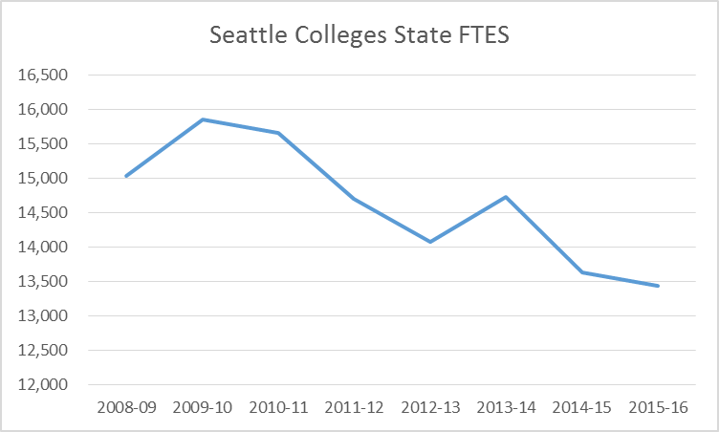
Seattle Colleges Enrollment
2009-10: 15,845 FTES
2015-16: 13,436 FTES
Note: Seattle Colleges “counted” International FTES in 2013-14

Slide 6
Seattle Colleges Enrollment
2014-15: 3,006 FTES
2015-16: 2,708 FTES
Note: Seattle Colleges “counted” International FTES in 2013-14

Slide 7

Enrollment / Staffing (Operating budget)
FY0910 to FY 1415

Slide 8
Enrollment / Staffing (Total budget)
FY0910 to FY 1415
Source: SBCTC Academic Year Reports

Slide 9
Fiscal Year 2017-18 Budget Proposal
(based on House budget)

Slide 10
Fiscal Year 2017-18 Budget Proposal (cont.)
(based on House budget)

Slide 11
Fiscal Year 2017-18 Budget Proposal
(based on House budget)

Slide 12
Fiscal Year 2017-18
Operating Budget Proposal

Slide 13
Fiscal Year 2017-18
Operating Budget Proposal

Slide 14
Fiscal Year 2017-18 Budget highlights
What it means:
Transitional budget to a new reality
Begins renewed focus on resource allocation in line with the Guiding Principles
Initiates momentum for increasing operational efficiency through integration

Slide 16
Student Success
E-learning project
Website project
Enrollment process improvement project
New library system
Program reductions
  Theater
  Opticianry
  B&TS – SVI
New programs
  BS in Nursing
  Digital Photography
  BAS in Multi-Occupational Trades Leadership
CRM (Customer Relationship Management)
Guided Academic Pathways
Investments in Student Learning Centers
District-wide expansion the of 13th Year Scholarship Program

Slide 17
Organizational Excellence
Highlights of Faculty Contract negotiations
  Increment increase
  Investment in Development Days
  Movement in addressing workload issues
  Additional full-time faculty positions
ctcLink
Enterprise Active Directory / IT
District-wide Emergency Planning
Seattle Colleges Student Portal
SVI
Continued focus on Instruction and Student Services budgets

Slide 18
Balance of Integration
& Differentiation
Dean of Nursing
Achieving System Integration – Phase 1
Towards a new Advancement / Foundation model
A new plan for Corporate and Continuing Education

Slide 19
Financial Stability
Reserves
Elimination / consolidation of administrative positions and functions
Achieving System Integration
Emphasis on appropriate class sizes
Shifting of faculty positions to high demand areas
District-wide Infrastructure and Energy Assessment Project
Program Viability process

Slide 20
Next Steps
Completion of Strategic Planning Process
Strengthening internal collaboration
Reviewing and implementing consultant and Task Force recommendations
State Budget finalized

