Slide 1
Board Budget Review
Fiscal Year 2012-2013
Kurt Buttleman, Vice Chancellor
Finance & Technology
Presented September 13, 2012
Board of Trustees Meeting

Slide 2
FY 2012-2013 Budget Summary
    Conservative Approach
Continued state reduction in funding
  State funding has decreased 22% in the last three years (from $70.9M to $55.1M)
Tuition burden continues to transfer to the student
Reduction of Instructional % of the budget due to a statewide change in coding for Instructional Deans
Strategy and approach to this year’s budget planning
Seattle Community Colleges is fiscally responsible for a budget of approximately $190M

Slide 3
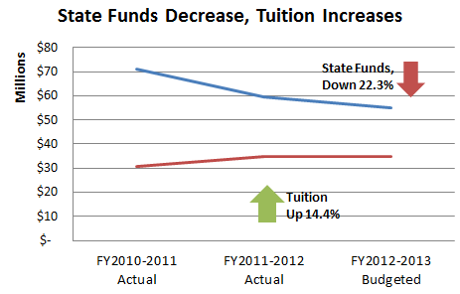
State Funding Decreases
      Since 2009, Community & Technical Colleges have had their state funding reduced by 23.5%
      Seattle Community Colleges has been pro-active in meeting this challenge
23.5%

Slide 4
Budget Committee Recommendations
        Process Efficiencies – Do things better!
        Generate Revenue
        Examination of part-time/full-time faculty
        Collaboration and Partnerships

Slide 5
New this year
Budget Review
This year's budget cut |  | (1.5%)
Tuition Increase 12% |  | $0
Net Reduction for FY 2012-2013 |  | $(1.3)

Slide 6
Current Major Budget Conversations
Budget Review
3% Classified Staff Salary Reduction
Tuition
  Tuition shortfall of $2.4M in 11/12
  Tuition Increase SBCTC approved the full 12% Legislatively authorized increase
  Tuition re-direct for ERP project 3%

Slide 7
Projected Tuition Revenue
FY 2012-2013
 | FY2011-2012 | FY2012-13
Enrollment | 97.2% | 96%
Current Tuition Collected | $32,571,213 | $34,999,021
Projected Tuition Allocation | $34,999,021 | $34,999,021
Projected Tuition Shortfall | ($2,427,808) | $0

Slide 8
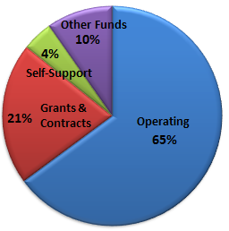
Funding
Sources
All Funds Budget Report

Slide 9
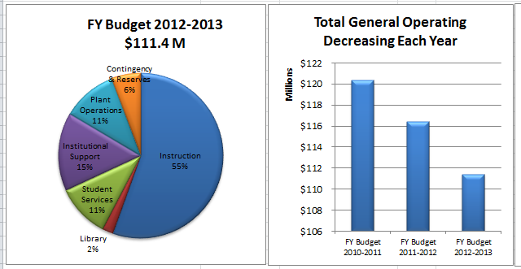
Operating Budget
Operating Budget

Slide 10
Year-End Financial Review
Kurt Buttleman, Vice Chancellor
Finance & Technology

Slide 11
FY 2011-2012 Year End Financials
    Summary
The Year End Financial Report for the Seattle Community Colleges demonstrates expected results as planned.
  Due to decrease in enrollment, tuition collection was $2.18M under target
  Within budget in major expense categories
  SVI fiscal status continues to be a topic of discussion with SCC Leadership.

Slide 12
FY 2011-2012 Year End Financials
    Demonstrated Fiscal Health
Seattle Community Colleges is well positioned in several fiscal health categories:
  Under budget for Operating Expenses by about 8%, which indicates accurate budget forecasting and effective expense management
    Conservative spending approach in anticipation of 13% reduction
  Reserves of $12.4 million are within our 5-10% requirement
  Local Funding sources remain strong as a group, despite tuition revenue being under the projected amount
  Cash balances in Running Start, International Students and Grants & Contracts remain stable and healthy
  Self-support programs continue to run positive cash balances
  Retail and other fund balances remain in healthy cash positions.

Slide 13
FY 2011-2012 Year End Financials
    Operating Budget
    Revenue Sources
Year End Financial Report

