Slide 1
Seattle Colleges Budget Planning Fiscal Year 2017-18
Shouan Pan, Chancellor
Kurt Buttleman, Vice Chancellor for Finance & Information Technology
Sheila Edwards-Lange, President – Seattle Central / SVI
Warren Brown, President – North Seattle
Gary Oertli, President – South Seattle

Slide 2
Timeline
Engage the Board of Trustees in setting policy directions for budget development and financial management (November)
Develop organizational plans and strategies that reflect strategic priorities (January – February)
Develop a preliminary budget (March – April)
Communicate the preliminary budgets to key stakeholders (May)
Budget approval and adoption (June)

Slide 3
State of Washington Budget
Governor
Net result = Seattle Colleges reduction of approximately $2,000,000
No tuition increase
ALL employee COLAs = 6%
Senate
Net result = Seattle Colleges reduction of approximately $3,000,000
Tuition increase of 2.0% in FY18 & 2.2% in FY19
Faculty COLAs of 5.0%
ALL other employees $500 increase to base salary
House of Representatives
Net result = Seattle Colleges reduction of approximately $1,500,000
No tuition increase
ALL employee COLAs = 6%

Slide 4
Federal Government
Department of Education
$11.6 million (currently)
Department of Labor
$9.5 million (currently)
National Science Foundation
$12.9 million (currently)

Slide 5
SBCTC Allocation Model changes
FY1718 Impact
Reduction of approximately $1,000,000
Potential Performance Based Funding changes
Negative impact on Seattle Colleges (and other urban districts)

Slide 6
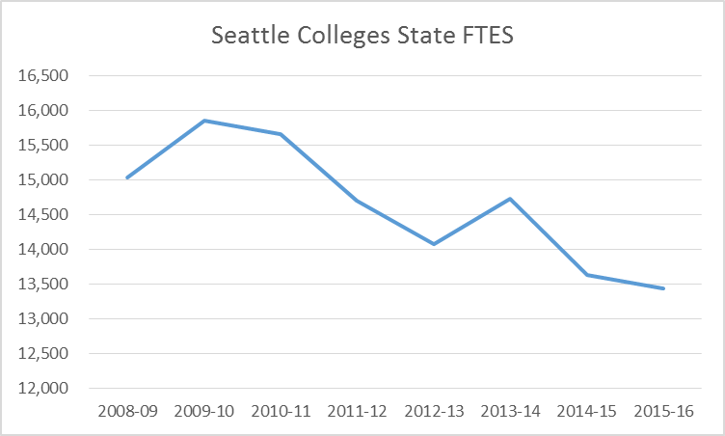
Seattle Colleges Enrollment
2009-10: 15,845 FTES
2015-16: 13,436 FTES
Note: Seattle Colleges “counted” International FTES in 2013-14

Slide 7
Seattle Colleges Enrollment
2014-15: 3,006 FTES
2015-16: 2,708 FTES
Note: Seattle Colleges “counted” International FTES in 2013-14

Slide 8
Local Issues
Increasing fixed costs
Decreasing class size
Integration vs. Differentiation impacts
ctcLink
$15 / hour
Faculty / staff contract costs
Faculty / staff recruitment and retention challenges
Satellite sites funding: SVI, Seattle Maritime, Health Education Center, Wood Technology Center, & Georgetown

Slide 9
Process challenges
Uncertainty on final budget allocation
Uncertainty of impacts of Achieving System Integration initiative
Concern about job loss from employees
Reliance on outside funding (grants/contracts/etc.) comes with increased cost for compliance

Slide 10
Seattle Central / SVI
What changes have been made or are being considered?
Instructional Programs
Program reductions
Program starts
The BS in Nursing – 30 FTE
Digital Photography – 25 FTE
Staffing reductions or reorganizations
Eliminate the Dean of BITCA position, $100,000
Eliminate the Assistant Dean of Work Force position, $85,000
Eliminate Dean of Extended Learning position, $100,000
Reduce part time faculty spending, $300,000
Revenue shifts
Reductions in budget to the divisions compared to the 17-18 budget are as follows:
President’s Office – $194,000
Instruction – $2,150,000
Administrative Services - $652,000
Student Services – $194,000
Increase in parking and rental income by $170,000
SVI operating expenses - $500,000+
Policy / practice changes
The changes include an increase in the average class size of .35 FTE
A shared services model with SVI that consolidates supervision for admin services and student services at SCC, and shifts some fundamental duties to SCC

Slide 11
Seattle Central / SVI
How are you leveraging limited resources to improve student success?
Telephone campaign to call students to boost retention
Embedded advising
Increased collaboration between student services and instruction
More partnering with external partners (i.e., Goodwill, Americorps)
Targeted outreach to specific populations
Consolidation and relocation of the Women’s Center, Veterans Center, etc.
What does your internal process look like?
College Council’s Budget Committee developed principles for budget reductions. These recommendations are considered by President’s Cabinet, the executive leadership team, and the instructional Deans.
The VP’s use these principles to guide their decision about how to reach their divisions’ targets for balancing the budget.

Slide 12
North Seattle
What changes have been made or are being considered?
Instructional Programs
The Theatre Department will close effective end of Spring Qtr 2017
Instructional Program Viability process is ongoing.
Development of a new instructional master plan is occurring.
Staffing/Organizational Structure: $1.75 Million Permanent Cuts Implemented
President’s Office - $27,717 Permanent Cut
Eliminated: Nonstudent Hourly Personnel
Eliminated: Goods & Svcs, Travel
Office of Instruction - $345,748 Permanent Cut
Eliminated: Dean Health & Human Svcs
Eliminated: Administrative Assistant, Workforce
Eliminated: Classroom Support Technician, E-learning
Eliminated: Assoc Dean Teaching & Learning
Eliminated: Assoc Dean E-Learning
Eliminated: Director Strategic Initiatives
Eliminated: Admin Assistant 4
Eliminated: Secretary Sr

Slide 13
North Seattle
Student Development Services - $56,825 Permanent Cut
Eliminated: Unnecessary costs, through Testing Office Restructure
Eliminated: Partial funding of Program Coordinator Position
Eliminated: Unnecessary costs, through Position Turnover
Reduced: Counselor Stipends
Reduced: Good&Svcs, Travel
Administrative Services - $351,438 Permanent Cut
Eliminated: IT Specialist 4
Eliminated: Partial funding of Bldg & Grounds Supervisor
Eliminated: 50% of Fiscal Specialist 1 position
Eliminated: Unnecessary costs, through Perm Position Turnover
Reduced: Nonstudent Hourly Personnel
Reduced: Goods & Svcs; Travel
Contingency Reserve - $304,345 Permanent Cut
Eliminated uncommitted operating contingency funds

Slide 14
North Seattle
Other - $97,799 Permanent Cut
Additional Permanent Level Cuts Implemented & Requiring Backfill: $573K
Utilities – $200,000 Permanent Cut
Adjunct Faculty Pool - $373,846 Permanent Cut
Revenue Shifts $3.58M
Carryforward $1M
International Programs Conversions $742K
Additional International Programs Backfill Funds $700K
Increase Running Start Revenues Permanent Allocation $175K
Additional Running Start Revenues Backfill Funds $200K
Increase Indirect Cost Recoveries Permanent Allocation $100K
Draw from Other Revenue Programs Fund Balances $660K
Policy / practice changes
All positions reviewed/approved by Cabinet
Strategic, Targeted reductions – no across the board cuts
Emphasis on preserving student facing programs

Slide 15
North Seattle
How are you leveraging limited resources to improve student success?
Investment in Student Learning Center (funded more by College than by student fees)
Call all new applicants within 24 Hrs
Learning from South’s Guided Pathways
What is the process you are following?
College Council’s Budget Committee developed principles for budget reductions.
The reduction recommendations are considered by President’s Cabinet, the executive leadership team, and the instructional Deans.
The VPs use guiding principles to guide their decision about how to reach their divisions targets for balancing the budget.

Slide 16
South Seattle
What changes have been made or are being considered?
Instructional Programs
Continuing to move forward with BAS in Multi-Occupational Trades Leadership and Nursing program
Planning for program review process for next academic year
Re-allocated vacant FT faculty positions to areas of growth (i.e. moved position from Landscape Horticulture to Academic Transfer)
Staffing / organizational structure
Eliminate Associate VP of Advancement ($114,000)
Have not refilled vacancies in:
Media Services Manager ($55,000)
Development Officer ($44,000)
Associate Director of Research ($80,000)
Continuing Education Manager ($55,000)
Moving forward to hire Director of Diversity, Equity & Inclusion position
Revenue shifting
Moving some staff positions on to fee accounts and grant budgets
Ensure appropriate cost recovery for rentals and partnerships
Policy / process changes
All positions reviewed/approved by cabinet
Strategic, targeted reductions - no across the board cuts

Slide 17
South Seattle
How are you leveraging limited resources to improve student success?
Moving forward on Guided Pathways work
Prioritizing investment of time/labor (i.e. creation of program maps, student processes)
Redirect traditional outreach to targeted efforts and on-boarding students
Increase enrollment through retention
Use of CRM
Continuing Completion Coach work
Grant-funded work is ending – shift to other funds to continue service
Expansion of 13th Year Promise Scholarship
Expect additional 100 students for 17-18 year = additional FTE
$1.5 million from City of Seattle, $9 million in private funds raised

Slide 18
South Seattle
What does the internal process look like?
February – Review and approval of Fees
March 15 – Provide Budget Development Worksheets to departments
March 15-31 – Discuss, plan, complete Budget Development worksheets
(during this time, Business Office available for training)
April 5 – Submit Budget Planning sheets to VP or President
April 10 – Submit Budget Planning sheets to Business Office
April 20 – College Council Budget Hearings
April 24 – College Council submit recommendations to President
April 25 – President’s Cabinet review and approve Budget
May 2 – Present Budget at SSC Public Hearing

Slide 19
District Office
Reduction in Purchasing Department ($71,027)
Budget Office re-organization ($18,000)
District-wide Nursing Program
International student processing staffing
Increased costs of doing business (i.e., events, catalog)
Effects of Achieving System Integration TBD

Slide 20
Next Steps
Internal collaboration
Consultant and Task Force recommendations
State Budget finalized

