Slide 1
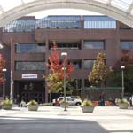
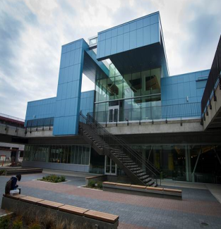
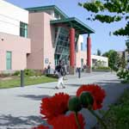
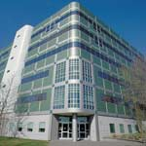
Central
SEATTLE COLLEGES
North
Public Budget Hearing
Fiscal Year 2015 - 2016
South
Presented June 9, 2015
North Seattle College
Dr. Jill Wakefield, Chancellor
SVI

Slide 2
Mission
Seattle Colleges
will provide excellent, accessible educational opportunities
to prepare our students for a
challenging future.

Slide 3
Strategic Plan 2010-2015
GOAL 1 – STUDENT SUCCESS
Increase Student Learning and Achievement:
Meet annual state-funded enrollment allocation Achieve 100% of our enrollment target
Increase student completion and job placement
Improve student achievement in pre-college math
Notes:
We achieved 96% of our enrollment target this year and if we had achieved 100% we would have increased tuition revenue by _______

Slide 4
Strategic Plan 2010-2015
GOAL 2 - PARTNERSHIPS
Build Community, Business and Educational Partnerships:
Increase Seattle Colleges’ economic impact and integral role in advancing social equity and social mobility.
Increase professional-technical program graduates to respond to local industry workforce needs
Increase private, foundation and local funding

Slide 5
Strategic Plan 2010-2015
GOAL 3 - INNOVATION
Increase innovation & improve organizational effectiveness:
Increase innovative instructional options for students
Improve effectiveness, efficiency and responsiveness of administrative systems
Increase employee ethnic and racial diversity and recognition

Slide 6
Seattle Colleges Budget Discussions
FY1516 Budget Issues
Enrollment and Student Success
Faculty and Staff wages
Limited changes to State funding for CTC’s
Tuition
Proposed SBCTC Allocation Formula Impacts

Slide 7
District Priorities for this Year
FY1516 Budget Priorities
Enrollment
Student Success Initiatives
Preparation for Major Fund-raising Campaign
Education Plan
Future Planning

Slide 8
SEATTLE COLLEGES
Public Budget Hearing
Fiscal Year 2015 - 2016
Financial Outlook
Dr. Kurt Buttleman
Vice Chancellor, Finance & Technology

Slide 9
State Funding
State Funding Outlook
Flat’ish’ State budget anticipated this year for SBCTC
Faculty and Staff COLAs
Earmarks (Pacific Tower, Labor Center, Maritime,
STEM, Aerospace)
Tuition level or decreased
Education
K-12 funding – McCleary
Capital
Cascade Court Reductions

Slide 10
FY1516 Budget Outlook
Key Updates to the SBCTC Allocation Model
Performance Funding (Student Achievement Awards) increased – 5%
Enrollment Performance
High Priority Programs
Limit on “counting” of International FTES (2%)
Increase in fees to International Students
Net impact to the Seattle Colleges
Reduction of $3M - $4M over 5 years (2016 – 2020)
Additional impact of lost tuition ($2M - $3M)

Slide 11
FY1516 Budget Outlook
Financial Management at Seattle District
Viable Financial Model
Long Range Planning
International Student questions
$15 / hour impacts
Negotiated agreements impacts
Staff / Faculty salaries
Board of Trustees Priority

Slide 12
District Office and District-wide
Key Discussions
Focus on Strategic Goals of Student Success, Building Partnerships, and Innovation
Creative Funding options such as grants and contracts
Focus on streamlining administrative activities
Reduction planning

Slide 13
District Office and District-wide
Funding Themes
Capital campaign
Marketing and enrollment
Enterprise IT
Efficiencies

Slide 14
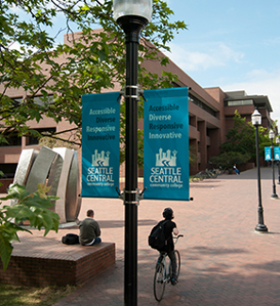
SEATTLE CENTRAL
Public Budget Hearing
Fiscal Year 2015 - 2016
Financial Outlook
Dr. Wai-Fong Lee
Interim Vice President, Administrative Services
Instruction and Finance

Slide 15
SEATTLE CENTRAL
Strategic Directions for 2015-2016
Selected from the objectives of the college’s Core Themes and Strategic Plan:
Increase domestic enrollment, retention and completion while promoting a culturally diverse campus and maintaining excellence in International education: Goal 1.B-D
Plan, develop and implement facilities improvements and expansion to meet current and future needs: Goal 3.C
Increase operational efficiencies and effectiveness: Goal 4.C

Slide 16
SEATTLE CENTRAL
Budget Challenges
Declining state enrollment:
Reduction in tuition collection/allocation
Higher costs/FTE given decreasing student/faculty ratios: average from 23 in FY12 to 21 in FY14
Funding for program redesign & improvement, launching new programs
e.g., BAS in Allied Health, Nursing, and IT Networking
Increasing dependence on revenue from international education programs:
headcount ceiling set at ~2,000

Slide 17
SEATTLE CENTRAL
Strategies: To Strengthen Programs, Increase Enrollment & Student Success, and Reduce Costs
Establish, revitalize, and redesign viable programs that meet student educational goals and market demand
Increase student completion and student achievement
Add stackable certificates and viable short-term programs
Promote program completion – all certificates and degrees
Provide clear pathways for all instructional programs
Integrate support services in all areas to improve effectiveness and efficiency
Convert part-time to full-time faculty positions – to improve program quality, operational efficiency, and reduce cost
Prepare multi-year plan for further budget cuts starting FY2016-17 based on the new allocation model
Expand marketing , outreach, and recruitment efforts

Slide 18
SEATTLE CENTRAL
Budget Implications
Total permanent budget adjustments expected for 2015-2016
Compared to Permanent Budget (FY 2014-15) | Amount
Decrease in tuition allocation | $ 1,000,000
Estimated funding for necessary new positions, position adjustments, and grant requirements | $ 515,200
Total | S 1,515,200

Slide 19
SEATTLE CENTRAL
A Challenging and Critical Year Ahead
-- A Year of Changes and Opportunities --
Fill top level positions: president and vice presidents
Work on initiatives to strengthen and improve instruction , support services, and student achievement
Address domestic enrollment with creative and effective approaches for marketing, outreach, and recruitment
Use continuous improvement approach to create an environment that encourages and supports student success
Develop strategies to address further budget cuts after FY 2015-16
Evaluate and determine the direction of international ed programs
Address space issues; work to expand and improve campus facilities

Slide 20
SEATTLE CENTRAL
Seattle Vocational Institute (SVI)
Planning Strategies
Align permanent budget with realistic enrollment projections, and establish a reserve fund
Improve operational efficiency and effectiveness
Integrate all support services with main campus
Implement “Program Success Studies” for all programs
Identify viable new programs to increase enrollment
Develop and implement marketing, outreach, and recruitment strategies, including community and business partnerships
Create strategies to address anticipated multi-year budget cut for FY2016-17+

Slide 21
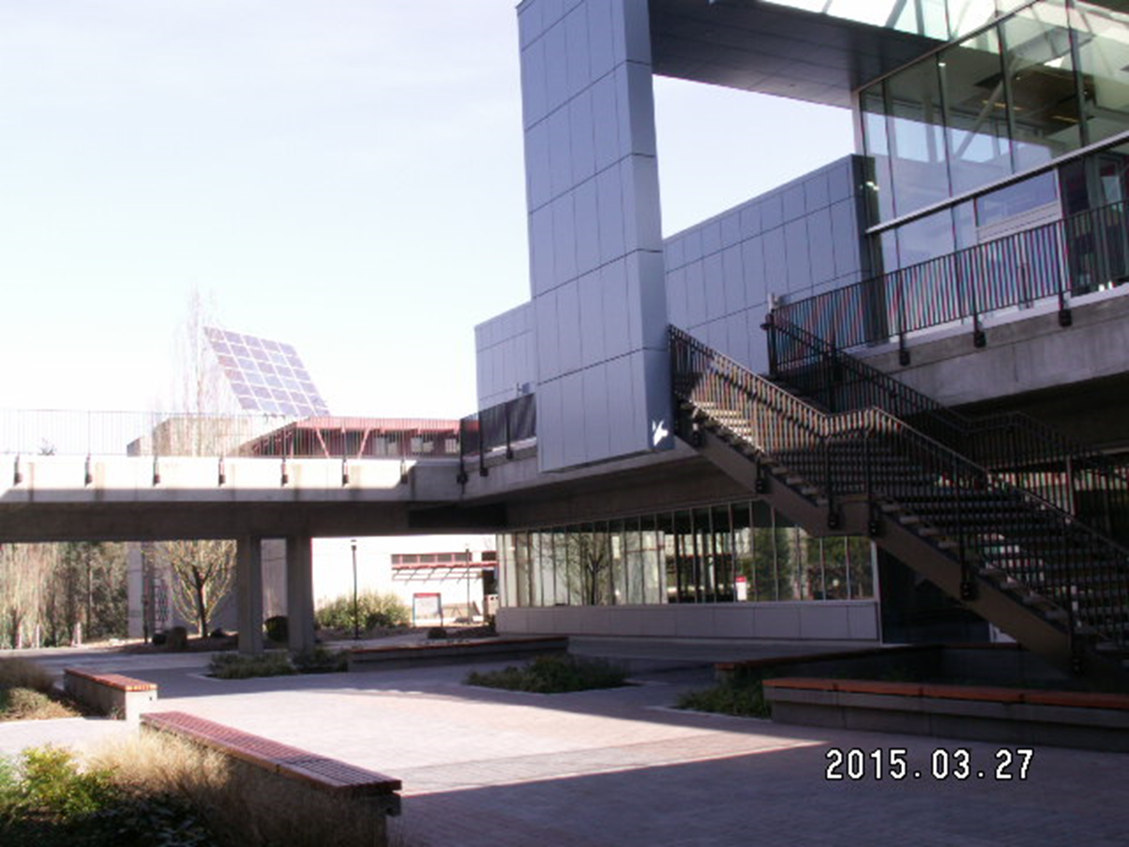
NORTH SEATTLE
Public Budget Hearing
Fiscal Year 2015 - 2016
Financial Outlook
Dr. Orestes Monterecy
Vice President, Administrative Services

Slide 22
NORTH SEATTLE
Strategic Plan Aligns with Budget & Budget Aligns with Strategic Plan
Core Themes and
Objectives
Core Themes and
Objectives

Slide 23
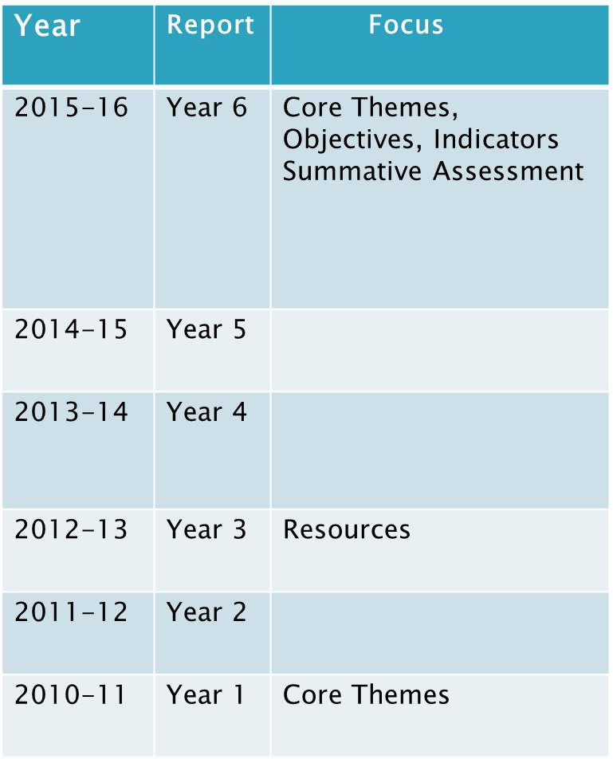
NORTH SEATTLE
Destination 2016
Aligning strategies
&
resources to achieve objectives

Slide 24
NORTH SEATTLE

Slide 25
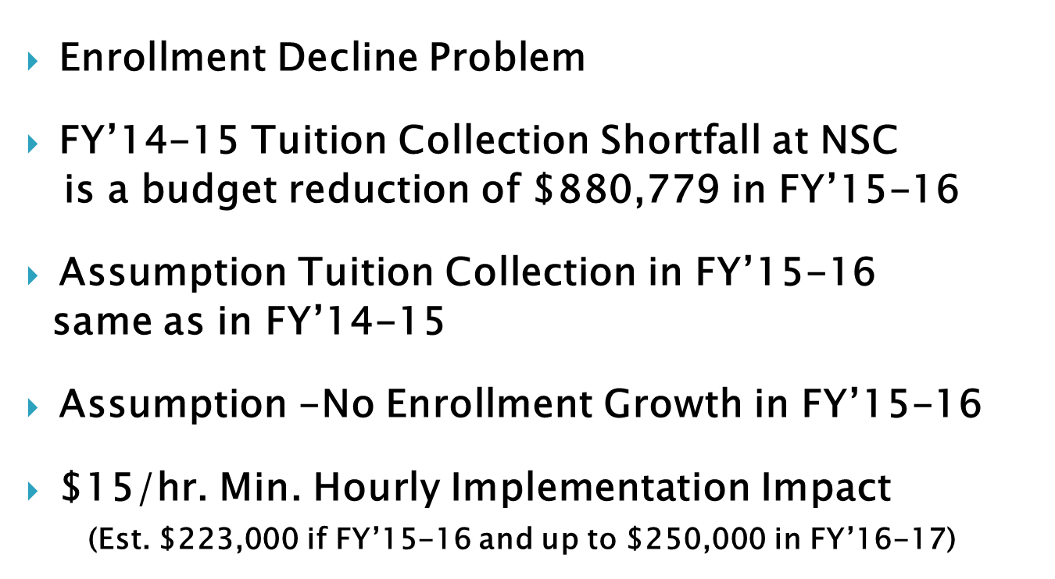
NORTH SEATTLE
Constraints for FY’15-16

Slide 26
NORTH SEATTLE
Budget Considerations in relation to CORE THEMES

Slide 27
NORTH SEATTLE
Advancing Student Success
Permanent
Increase Std. Learn Ctr. funding by $236,000
Temporary
Std. Learn Ctr. Office Assistant $46,526
Shared Credential Specialist $15,000
Financial Aid Prog. Coord./or Hrly. $54,343
LB Increase in Book Funding $39,000

Slide 28
NORTH SEATTLE
Excelling In Teaching and Learning
Permanent Positions
Institutional Effectiveness @ 100% adjust. $25,400
Temporary Positions
HHS Clinical Coordinator $48,000

Slide 29
NORTH SEATTLE
Building Community
Permanent
President’s front desk senior sec. $15,500
Temporary
Art Gallery Coordinator $21,000

Slide 30
NORTH SEATTLE
How Budget Considerations Distributed

Slide 31
NORTH SEATTLE
Next Stop, 2016: Our Preferred …

Slide 32
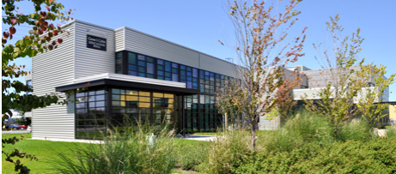
SOUTH SEATTLE
Public Budget Hearing
Fiscal Year 2015 - 2016
Financial Outlook
Dr. Frank Ashby
Vice President, Administrative Services

Slide 33
SOUTH SEATTLE
South Had a Great Year
Focused on the Student Success
Invested in Technology and Infrastructure
Reinstated outside resource solicitation to supplement the College programs and services

Slide 34
SOUTH SEATTLE
Budget Challenges
State allocation is not finalized
Tuition collection for 2014-15FY
No projected increase in State allocation
No tuition increase
Cost recoveries are approaching its limit
Mandatory commitments
Unfunded mandates
Sunset grants

Slide 35
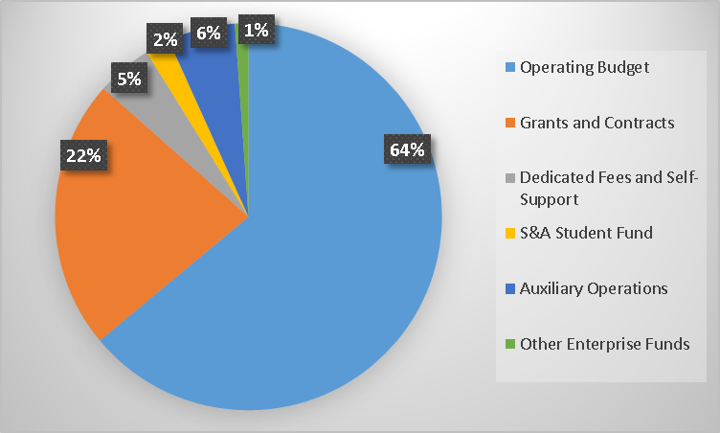
SOUTH SEATTLE
SSC Total Resources $52Million

Slide 36
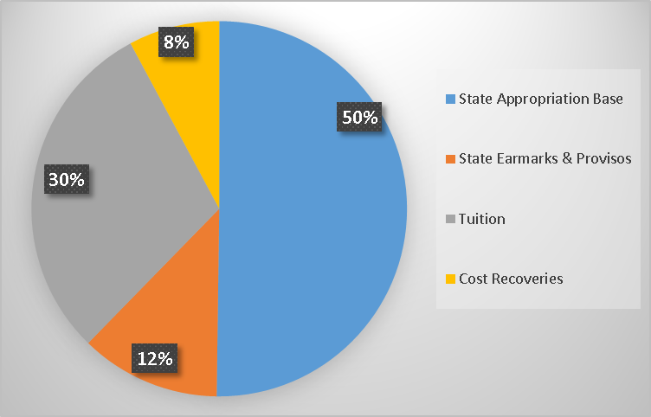
SOUTH SEATTLE
SSC Operating Budget $33Million

Slide 37
SOUTH SEATTLE
Budget Principles
2015-16 FY
SSC will align budget priorities with the strategic plan and core themes.
SSC will follow its policy regarding fund balance and reserves. Fund balance and reserves will not be used for on-going expenses.
SSC will continue grant acquisition to financially supplement college programs. Sustainability of continuing grant activities beyond the life of the grant will be considered in budget development.
SSC will develop a realistic and sustainable budget based on historical data, enrollment trends, revenue forecasts, and program and operational reviews.

Slide 38
SOUTH SEATTLE
SSC Core Themes
Student Achievement
Teaching and Learning
College Culture and Climate
Community Engagement and Partnership

Slide 39
SOUTH SEATTLE
College Council
2015-16 FY
Acknowledged that resources are very scarce this budget cycle, and recommendations may be more that can be covered in the budget
Strongly recommended fully fund mandatory costs

Slide 40
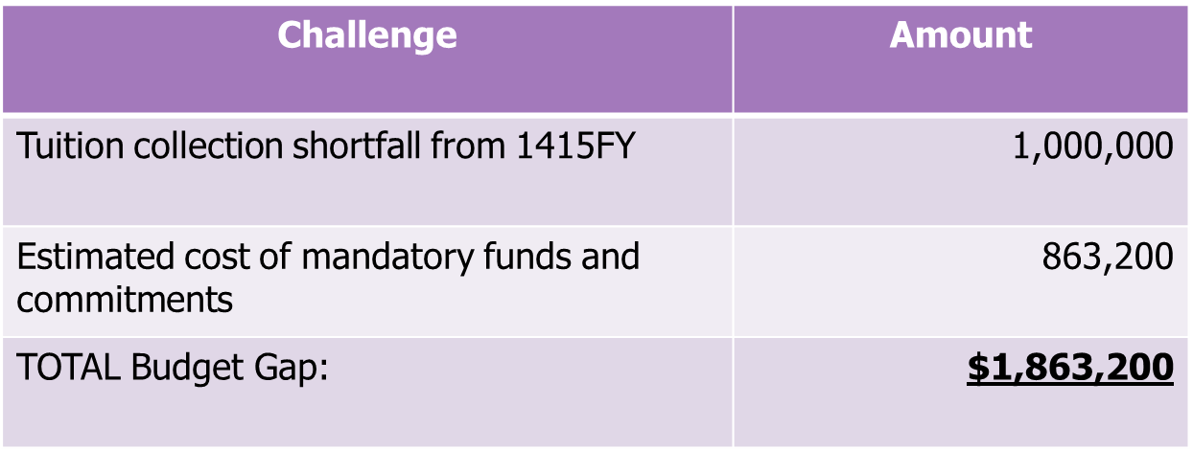
SOUTH SEATTLE
Budget Gap
2015-16FY

Slide 41
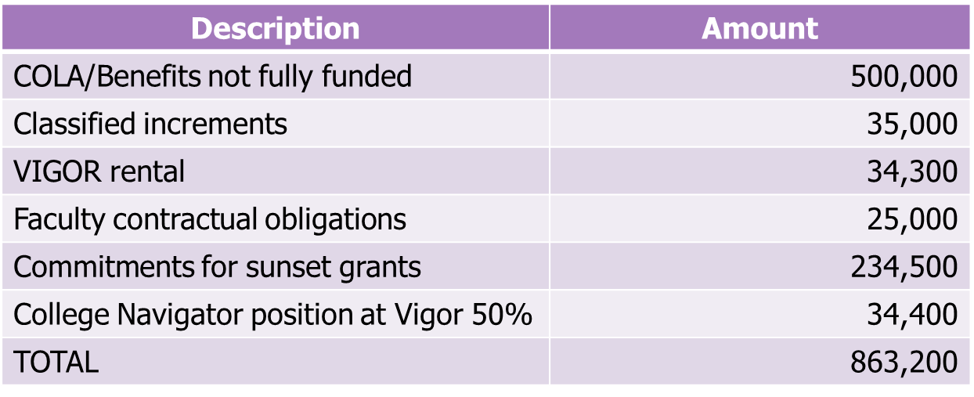
SOUTH SEATTLE
Mandatory Costs and Commitments

Slide 42
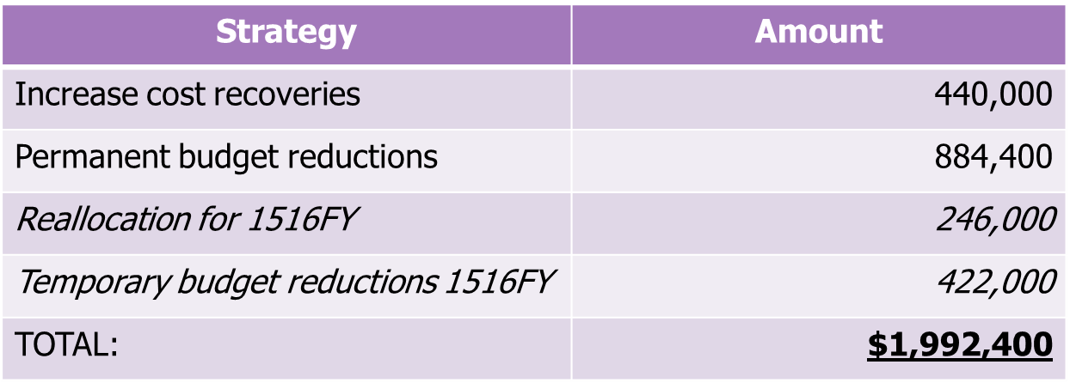
SOUTH SEATTLE
Budget Balancing
2015-16 FY

Slide 43
SOUTH SEATTLE
Budget Development Outcome
2015-16FY
South’s Permanent Operating Budget is NOT Balanced

Slide 44
SOUTH SEATTLE
Budget Development Key Points
2015-16FY
We came a long way to close the budget gap!
2015-16FY Budget is NOT Balanced
Current level of funding for 2015-16FY is NOT Guaranteed. Certain things will never go back to how they used to be.
Be prepared for more changes

Slide 45
Budget Hearing
Questions & Discussion?
Thank you all for attending

