Slide 1
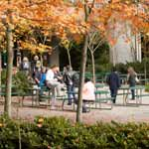
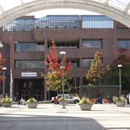
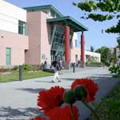
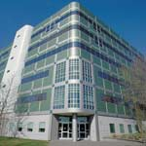

SEATTLE COMMUNITY COLLEGES
Board of Trustees
Budget Presentation Fiscal Year 2011-12
Presented Thursday, September 8, 2011
North Seattle Community College

Slide 2
Focus of Presentation
Focus of Presentation
What is Our Mission?
Strategic Goals to Accomplish Mission
Budget Planning Process Used
Enrollment Targets/ FTE History
Funding Available to Reach FTE Targets
Challenges

Slide 3
Seattle Community College District
MISSION
    Seattle Community Colleges will provide excellent, accessible educational opportunities to prepare our students for a challenging future

Slide 4
District-wide & District Office
Strategic Plan -- 2010-2015
District-wide Strategic Goals
Goal 1: Student Success – Increase Student Learning and Achievement
    Goal 2: Partnerships – Build Community, Business & Educational Partnerships
    Goal 3: Innovation – Increase Innovation & Improve Organizational Effectiveness
    District Office Strategic Goals
    Goal 1: Support College Priorities and Initiatives
    Goal 2: Ensure Business Systems/Processes are Effective, Efficient, and Responsive
    Goal 3: Increase Awareness of the Significant Impact of the Seattle Community Colleges

Slide 5

Budget Planning Process
    Chancellor Reconvened District Budget Planning
    Committee
  Colleges/District Office Planned for 10% cut beginning in January
    Colleges/District Office used Similar Planning
    Processes
    Anticipated cuts of up to $8.2 mil for District
  Colleges/District also needed to account for the FY 10-11 3.8% supplemental cut

Slide 6
District-wide Budget Committee Recommendations
      Process Efficiencies
      Centralization
      Revenue Generation
      Examination of part-time/full-time faculty
      Collaboration

Slide 7
District-wide Budget Committee Recommendations
PROCESS EFFICIENCIES
      Further restructuring of management positions and departments across the district and within colleges
      Streamlining, centralizing and/or automating enrollment processes to give students greater ability to enroll at more than one of our campuses
      Examine the effectiveness of the use of S&A fees and the transparency of the process for the allocation of these funds at all campuses

Slide 8
District-wide Budget Committee Recommendations
PROCESS EFFICIENCIES (previous recommendations)
      More efficient use of space and buildings; continuation of the goal to increase sustainable practices
      Minimize the use of outside consultants and contractors
      Increase the use of electronic forms

Slide 9
District-wide Budget Committee Recommendations
CENTRALIZATION (previous recommendation)
      Increased centralization of “back office” functions

Slide 10
District-wide Budget Committee Recommendations
REVENUE GENERATING
      Examine the reliance on soft money (i.e., international students) while keeping mindful of the district’s mission
      Local taxing authority, competing for levy funds

Slide 11
District-wide Budget Committee Recommendations
REVENUE GENERATING (previous recommendations)
      Pursue more grants & charge indirect costs
      Explore differential tuition & fees, and flexibility in utilizing fees for state-support classes

Slide 12
District-wide Budget Committee Recommendations
COLLABORATION (previous recommendation)
      Move to common placement testing standards

Slide 13
SEATTLE COMMUNITY COLLEGES
Board of Trustees Budget Presentation
Fiscal Year 2011-12
Now for the Numbers
Alan Ward Interim Financial Officer

Slide 14
What Does the Budget Picture Look Like?

Slide 15
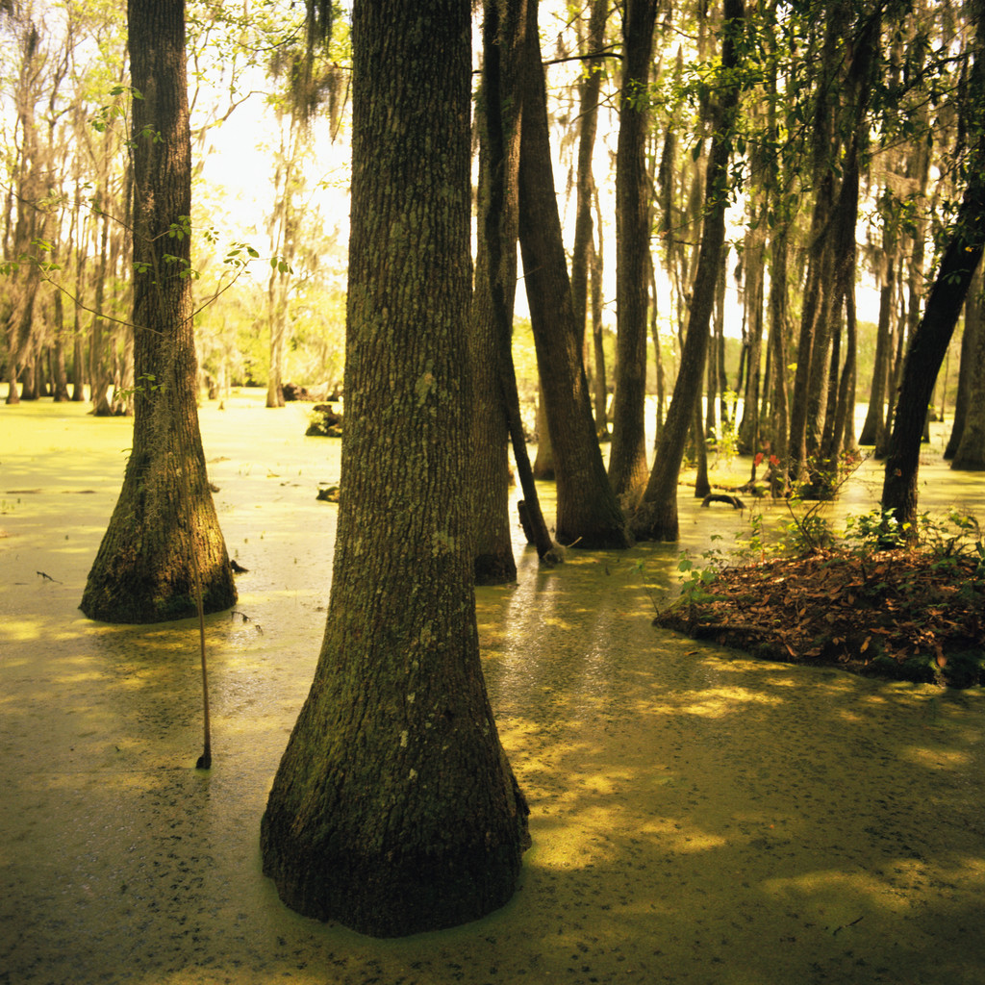

Slide 16
Budget for 2011-13 Biennium
Legislature dealt with $ 5 bil revenue shortfall
Couldn’t raise taxes-initiative I-960
State appropriations were cut
Legislature reduced CTC funding by $76.8 mil or 11.5% for FY 2011-12
$84.3 mil or 12.6% for FY 12-13 (1.1% more)
CTC current State funding drops from $669mil to $585 mil in FY12-13

Slide 20
2011-13 Higher Education Operating Budget
State Funds and (Base) Tuition Revenue as a Percent of Institutional Budget

Slide 21
Major Budget Components by Percent Change in General Fund Appropriations 2007-09 through 2011-13

Slide 22
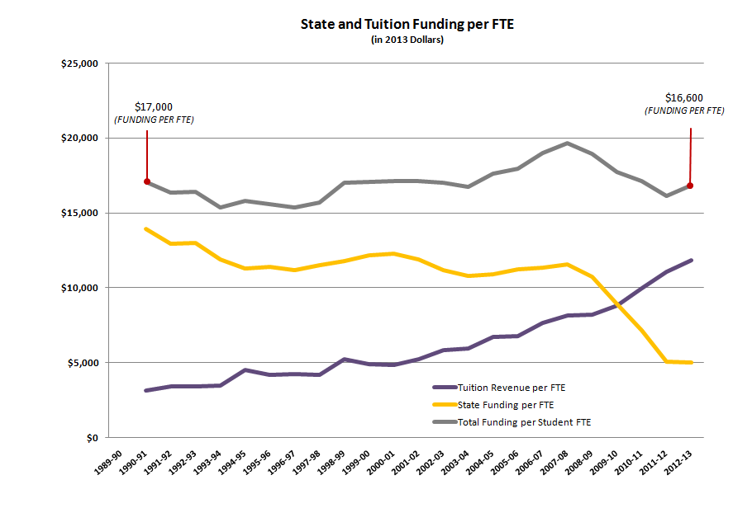
University of Washington
State and Tuition Funding per Full Time Equivalent Student

Slide 23
How We Started FY 2010-11
July 1, 2010 General Budget Cut $4,007,146
Compensation Cut $720,025
Total Cut $4,727,171
Tuition Increase -7% $4,350,083
Net Reduction for FY 10-11 $377,088

Slide 24
Things Were OK THEN!
Revenue Targets Missed/Forecasts were lowered
Sales/Business taxes generate over 50% of State revenue- revenues missed forecasts
Governor implemented a 3.8% supplemental budget reduction in December
This was another $2,688,021 budget cut for the District

Slide 25
State Budget Reduction History
      FY 2008-09 Reduction of $3,132,000 (reported as 4.3% by SBCTC)
      FY 2009-10 Reduction of $5,112,157 (reported as 6% by SBCTC)
      FY 2010-11 Reduction of $4,007,106 (reported as 5.5% by SBCTC)
      FY 2010-11 Reduction of $720,025 (compensation reduction)
      FY 2010-11 Supplemental Reduction of $2,688,021 (3.8%)
      Ordered by Governor in December 2010

Slide 26
Key Reductions for the District
for FY2011-2012
Permanent Budget Reduction | ($5,058,712)
Suspend PERS/TRS Plan 1 COLA | ($328,318)
Cap State Funding for TIAA-CREF Plans @ 6% | ($741,664)
One-Time Reduction | ($430,593)
Temporary 3% Salary Reduction | ($1,631,632)
ERP Advanced Planning | ($203,398)
TOTAL | ($8,394,317)

Slide 27
Tuition increases of 12% per year for resident students and upper division applied baccalaureate tuition (but 2% of operating fee for CTC Innovation Account/ERP – Enterprise Resource Planning*)
One-time compensation reduction from FY2010-2011 of $720,025 added back
* a system that integrates finance, HR, academic and student service processes, data, and information across an entire organization (CTC)
Key Additions for the District
for FY2011-2012

Slide 30
Projected Tuition Revenue
FY 2011-2012
 | FY2010-2011 | FY2011-2012
Enrollment | 100% | 100%*
Current Tuition Allocation | $30,598,643 | $30,598,643
Projected Tuition Collected | $32,478,159 | $34,914,021**
Projected Additional Tuition | $1,879,516 | $4,315,378**
*Assumes SCCD generates similar FTES as FY2010-2011 (approx 15,600) despite having less projected funding for WRT FTES in FY2011-2012 (500-600 less)
** New Tuition Allocation Amount for FY2011-2012 assumes net 7.5% tuition revenue increase and similar FTE generation ($4.3M above FY11 allocation; approx $2.5M more than what was collected in FY11)

Slide 31
Budget/FTE Target for FY11-12
      Total FY 11-12 Operating Budget $105,442,764 for District
      State funding $57,518,523
      Tuition Funding $34,914,021
      Offsets $13,010,220
      What are offsets?
      International Revenue $8,715,606
      Indirect Charges $1,955,018
      Running Start $1,664,000
      ABE $675,636

Slide 33
Other Budget Concerns for
11-13 Biennium
Revenue Continues to Fall Short of Forecasts
Possibility of Another Supplemental Cut
Will Enrollments Remain Strong?
Groundhog Day in Washington D.C.

Slide 34
Seattle Community Colleges FY2011-2012
End of Presentation
Questions & Discussion?

Slide 35
DW Budget Presentation
FY 2011-2012
Special thanks to North Seattle Community College for hosting this presentation.

Slide 36
Approval of Budgets by Board
See Handouts

