Slide 1
Bachelor of Applied Science in Hospitality Management
Hana Gala and David Krull
Program Name
Goes Here
Presenter Name Goes Here
Notes:
Welcome, introduce yourself and the program. Feel free to share about your education/career background, how long you’ve been teaching, etc.

Slide 2
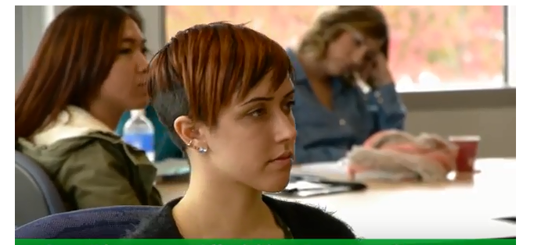
What is hospitality management?
Multiple pathways to success
Tourism: Hotel operations, airlines, cruises, destination spas and resorts
Restaurants, bars, cafes, catering, food entrepreneurship, casinos, clubs
Event production, venue management, promotion
Assisted and independent living facilities
Corporate hospitality and dining

Slide 3
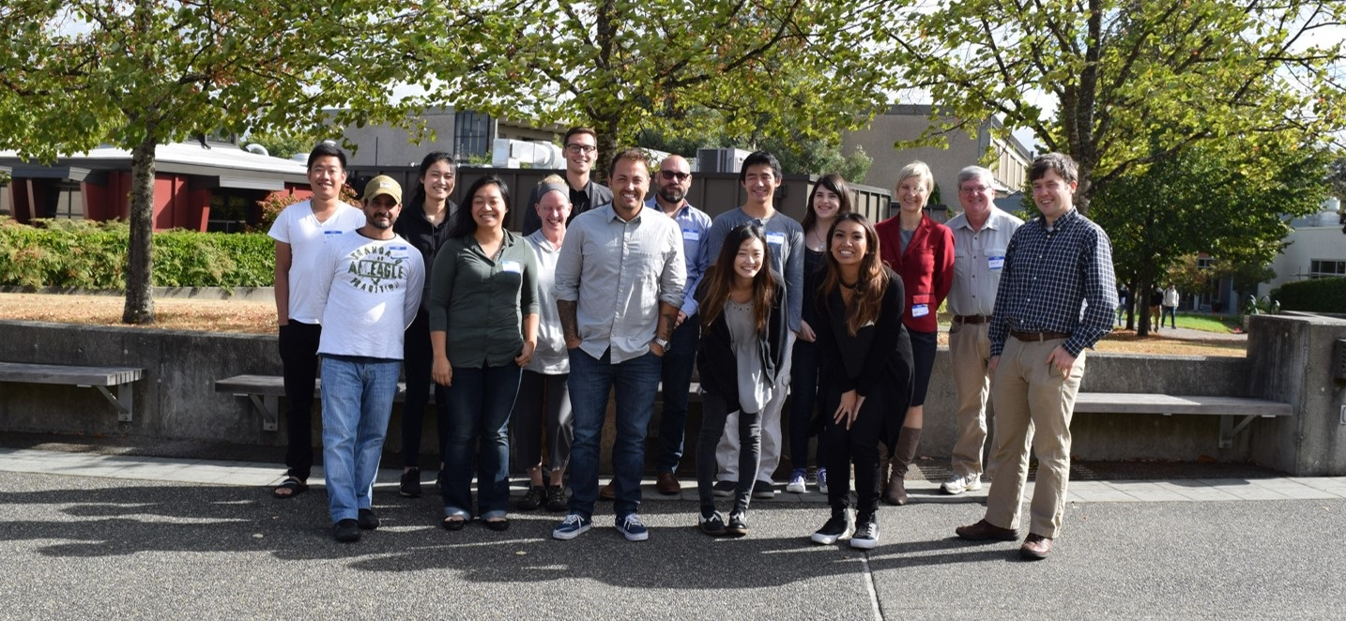
What’s in the program?
Two years of upper-division coursework for a bachelor’s degree
Focus on applied, real-life challenges with cohort of your peers
Hands-on, industry-driven content
Two days a week of virtual instruction with guaranteed schedule
Expert instructors and guest speakers
Events, tours, and networking

Slide 4
What is the Hospitality Management BAS?
The Hospitality Management Bachelor’s of Applied Science Degree
4-year program at South Seattle College (2 years on top of AAST or AAS)
2+2 bachelor’s (90 credits of Associate Degree + 90 credits of Bachelor’s) or
60 AA + 30 GEN ED CLASSES (90 credits total)
60 HMG Core + 30 GEN ED CLASSES (90 credits total)
180 credits* = BAS degree
Best value for $$$ ($2,104.75/quarter, or $12,600 total*)
Assuming 6 quarters and 15-credit load each quarter
Many resources for financial aid and scholarships

Slide 5
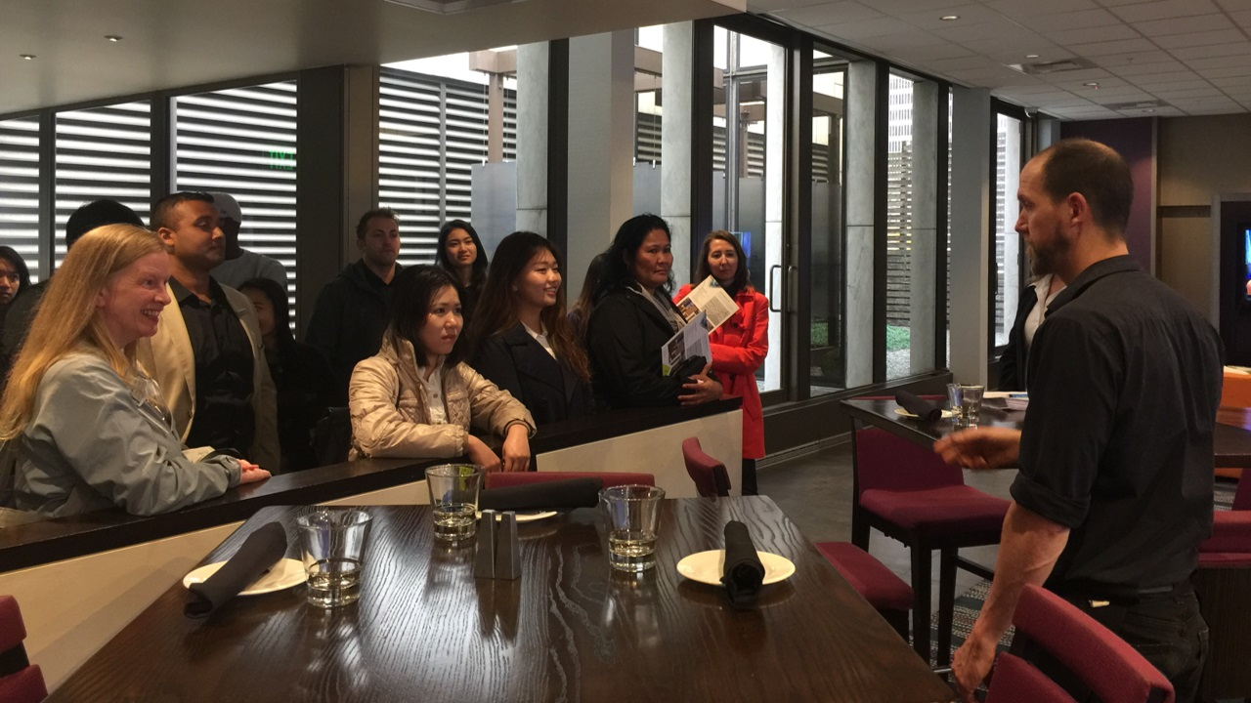
Program benefits
Connects you with a network of professionals and potential mentors
Excellent value with low tuition and fees
Multiple opportunities for financial aid and scholarships
Prepares you for supervisory and management jobs

Slide 6
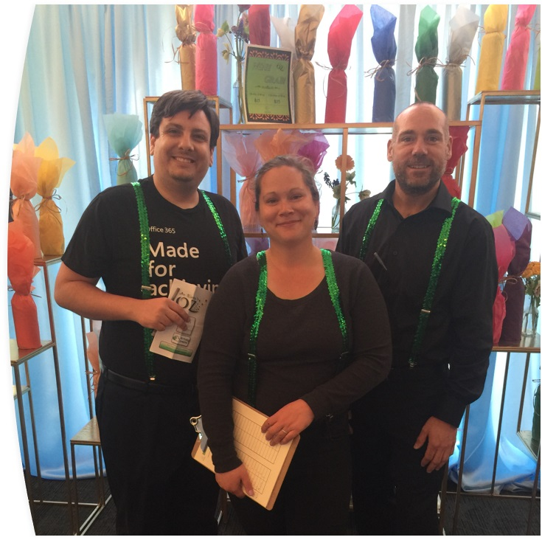
What you learn
Topics include
Human resources
Management skills
Accounting
Service operations
Business law
Game-based virtual applications and simulations

Slide 7
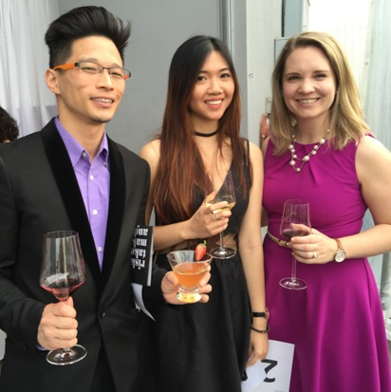
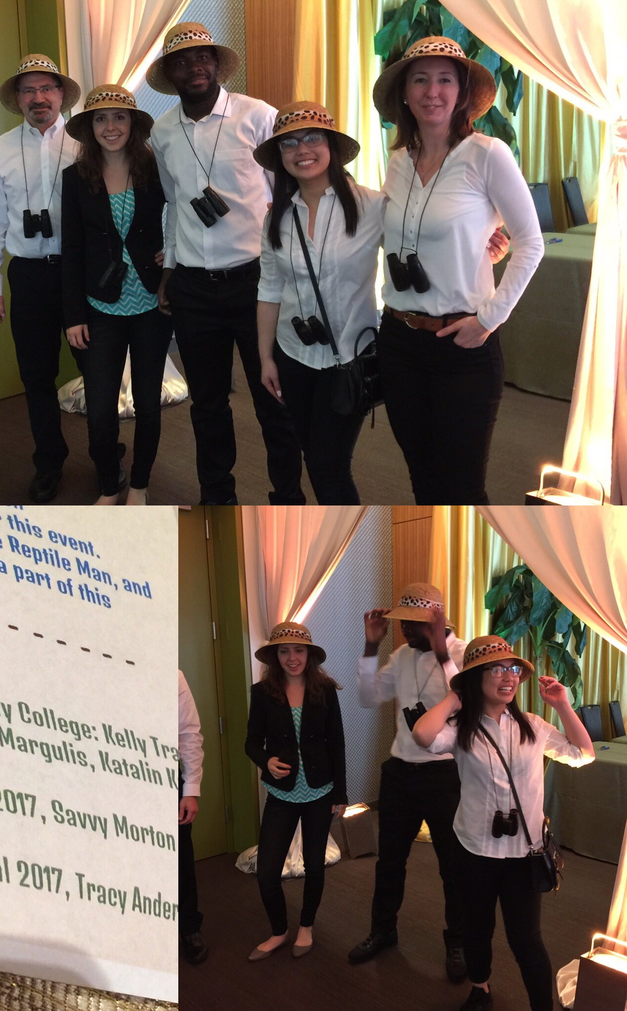
Connect with us
Faculty
Hana.Gala@SeattleColleges.edu
David.Krull@SeattleColleges.edu
Program Manager: Megan.Sears@seattlecolleges.edu

Slide 8
Contact info
Hana Kabele Gala, Hana.Gala@SeattleColleges.edu
Visit http://www.southseattle.edu/bas/hospitality-management/
Learn more https://go.seattlecolleges.edu/form/inquirysouth
Our social media
Facebook: Hospitality at South @SSCC.BAS https://www.facebook.com/SSCC.BAS
Instagram: @HMGatSOUTH

Slide 9
Return to Main Session
(select “Leave Breakout Room” to return)

