Slide 1

School of Apparel Design & Development
Tanya Knannlein – Instructor / Coordinator
Program Name
Goes Here
Presenter Name Goes Here
Notes:
Welcome, introduce yourself and the program. Feel free to share about your education/career background, how long you’ve been teaching, etc.

Slide 2
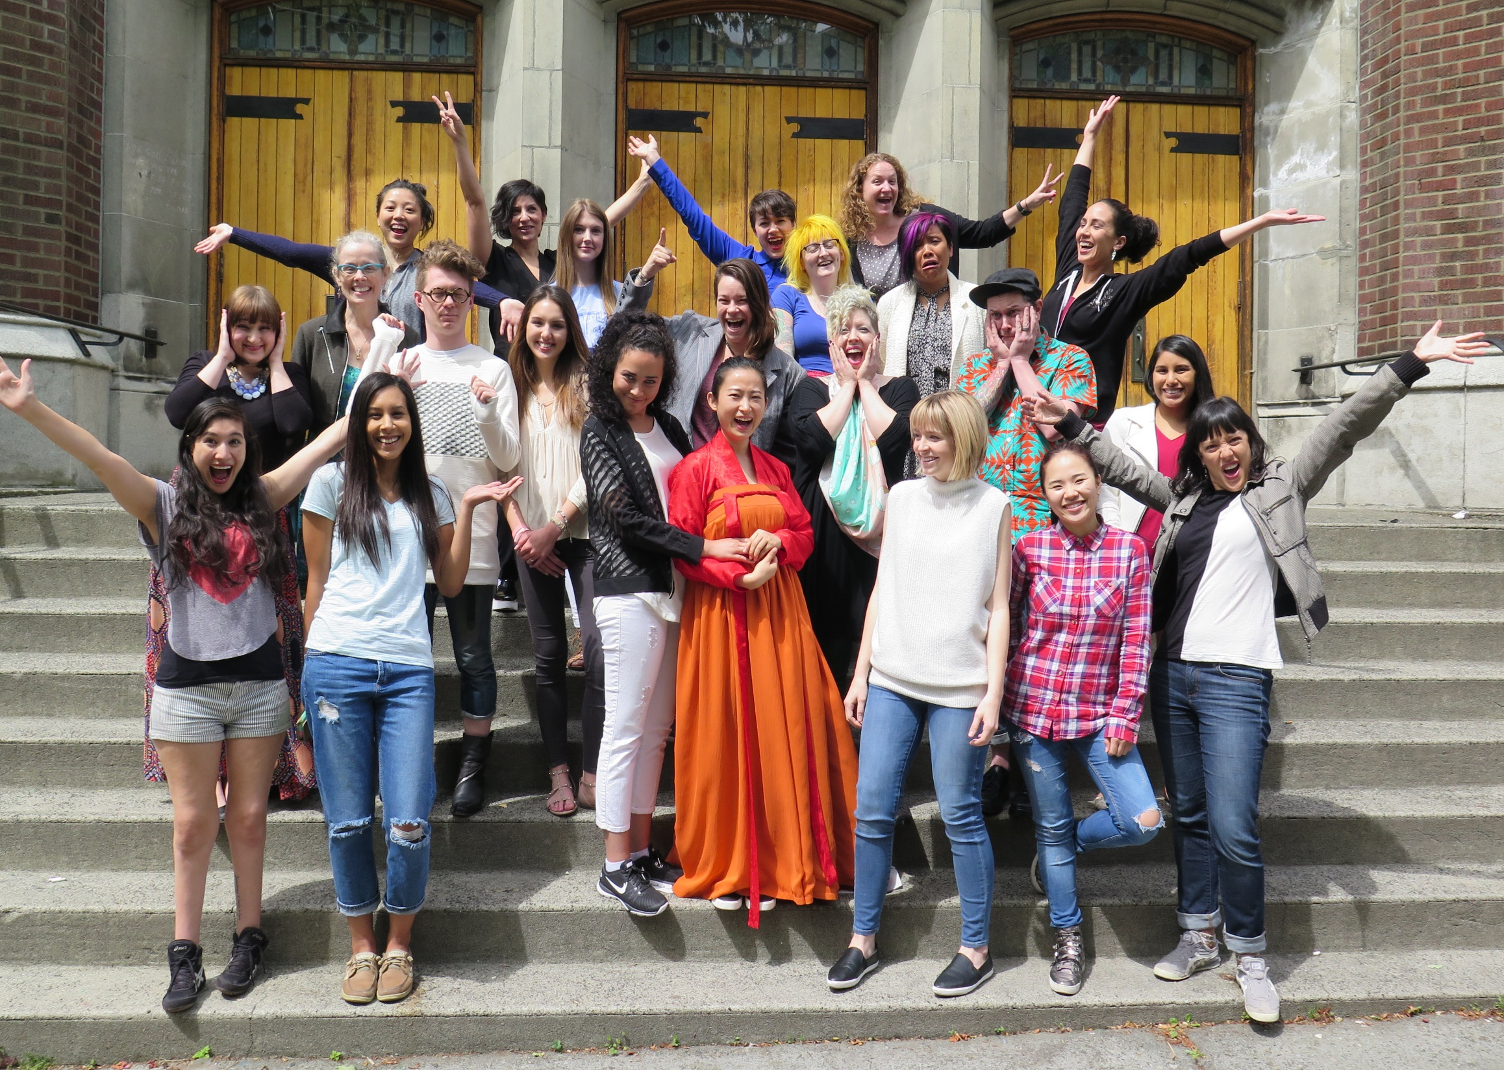
WELCOME!

Slide 3

Our
Promise
We provide RELEVANT technical and creative training that prepares students to succeed in a competitive industry. AD&D is always aligned to apparel industry trends. Graduates of our program get jobs as assistant designers, technical designers, product developers, patternmakers, costumers and stylists.

Slide 4
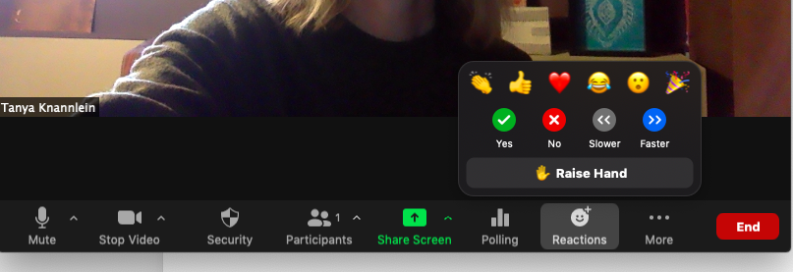
Ask Questions at any time!

Slide 5
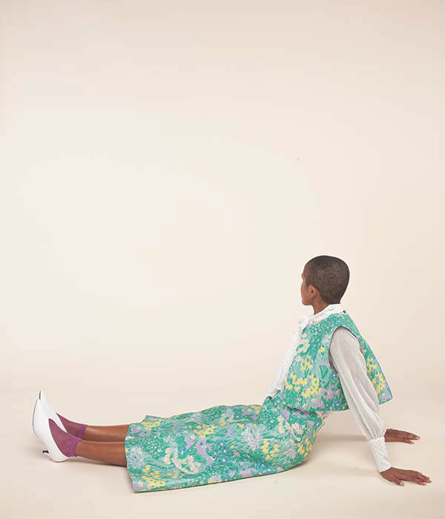
CURRICULUM
Two years, six-quarters, full-time
Lock-step curriculum + Internship
Integrated math and English
Seattle Central College - 10,000 square foot studio and classroom
Associate of Applied Sciences Degree
Julia Kernerman 2017
OUTDOOR RESEARCH - COLORIST

Slide 6

CAREER OPPORTUNITIES
DESIGNER
PRODUCT DEVELOPER
PATTERNMAKER
TECHNICAL DESIGNER
TEXTILE DESIGNER
STYLIST
COSTUMER
Alvin Antonio 2017
ZULILY - STYLIST

Slide 7
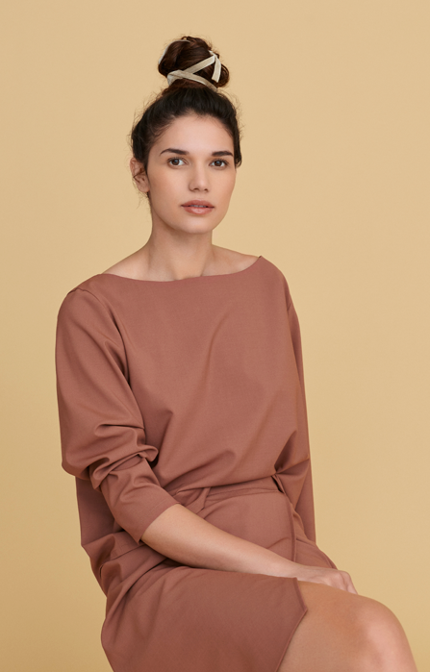
ARE YOU A GOOD FIT?
YOU WANT A CREATIVE CAREER
YOU ARE WILLING TO work hard
YOU WANT TO WORK with a team
YOU WORK WELL UNDER deadlines
YOU ENJOY PROBLEM SOLVING
Juliet Sander 2017
NORSTROM – ASSISTANT DESIGNER

Slide 8
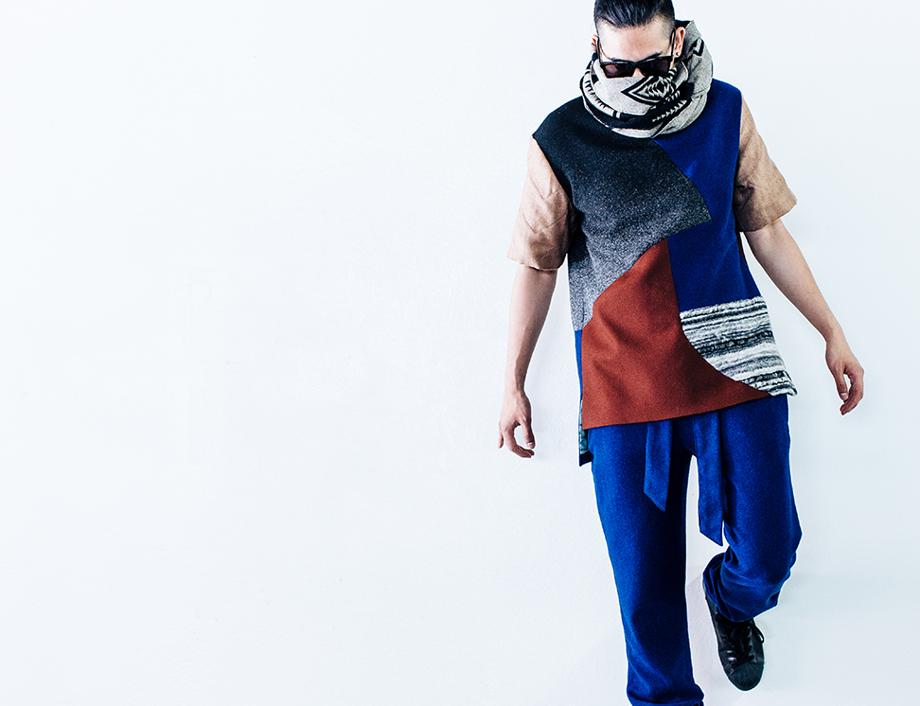
CURRICULUM THREADS
CONSTRUCTION
PATTERNMAKING
DESIGN
TECHNOLOGY
PROFESSIONAL DEVELOPMENT
HISTORY & SOCIAL INFLUENCES
CAPSTONE
BASIC SKILL DEVELOPMENT
Erin Motley 2015
”CAPTAIN FANTASTIC” SET DRESSER
Allen Wilson 2017

Slide 9

Construction
READY-TO-WEAR
ACTIVE SPORTSWEAR
MASS PRODUCTION METHODS
TAILORING
FITTING
Hyein Lee 2019
OWN BRAND

Slide 10

patternmaking
DRAFTING
FLAT PATTERN
DRAPING
GRADING
COMPUTERIZED DRAFTING & GRADING
Basak Yurtoglu 2015
A to Z – DESIGN ASSISTANT

Slide 11
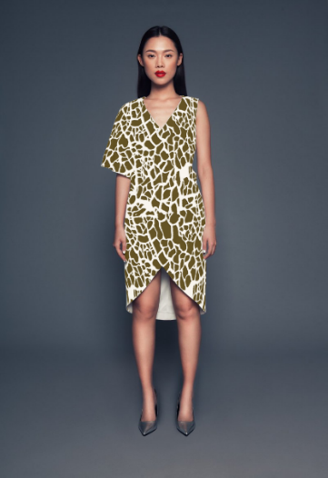






Design
Sequiria Johnson 2018
PRINCIPLES
FABRIC SCIENCE & TEXTILES
Celine Waldman 2018
COLOR & PALETTES
PRINT & PATTERN
LINE DESIGN
Orlando Mandujano 2018
AD&D TEXTILE DESIGNS

Slide 12

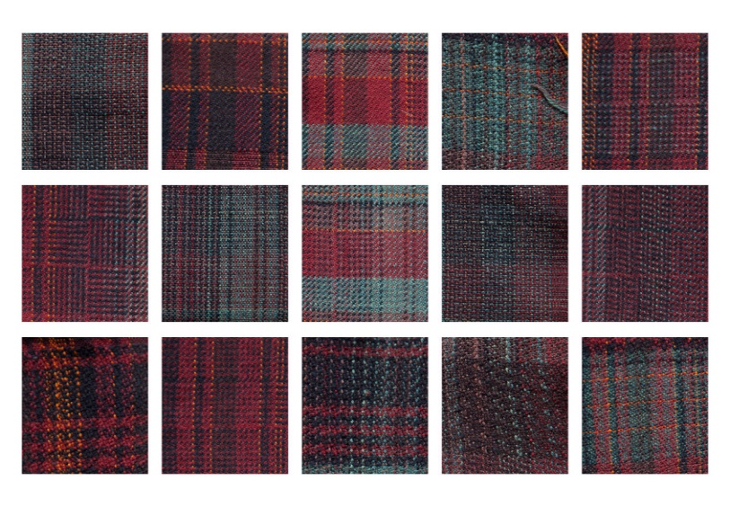
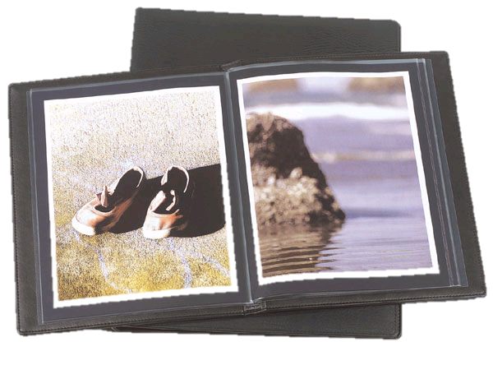
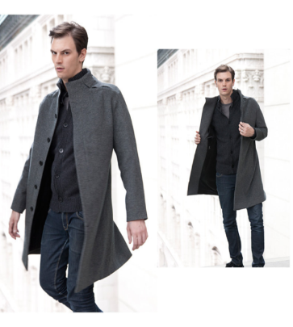
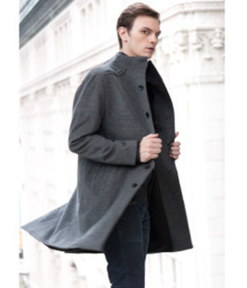
Professional development
BUSINESS IN FASHION
APPAREL MANUFACTURING
WORK EXPERIENCE
COMMUNICATIONS
PRESENTATION
RESUME DEVELOPMENT
JOB SEARCH STRATEGIES
Tom Milewski 2011
TOMMY BAHAMA –
ASSISTANT DESIGNER
CAREER & JOB EXPLORATION

Slide 13
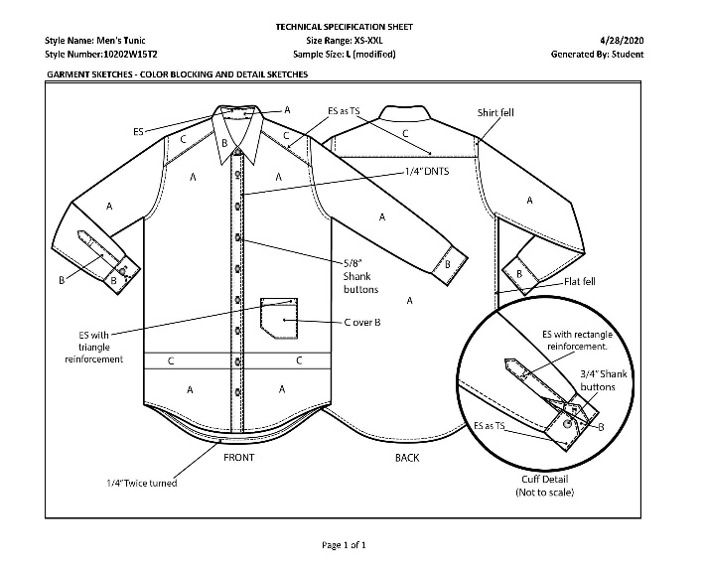
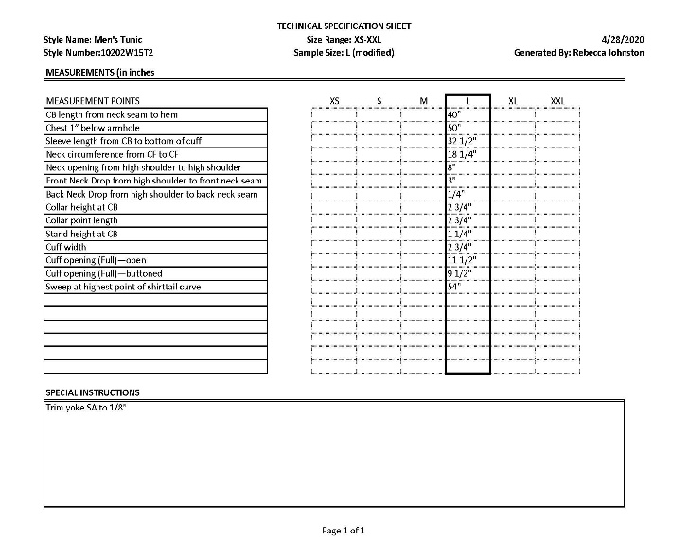
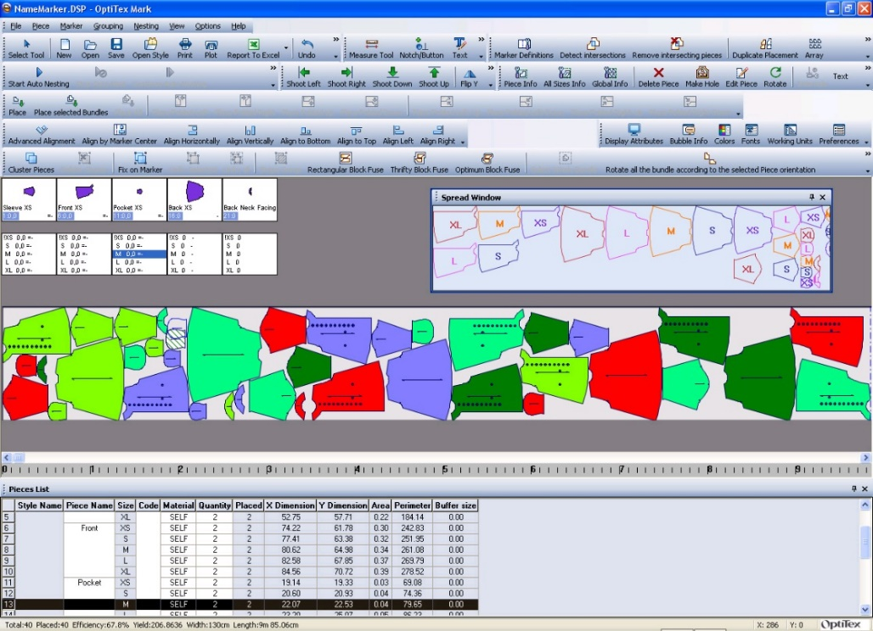
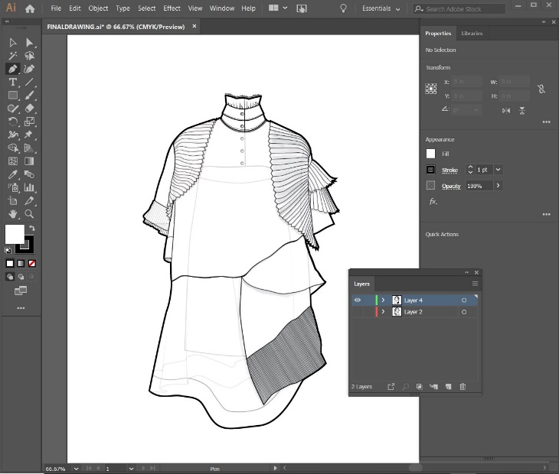
Computer technology
TECHNICAL SPECIFICATIONS
PATTERN DEVELOPMENT
PATTERN SIZING
GRAPHICS APPLICATIONS
PRESENTATION
PORTFOLIO

Slide 14
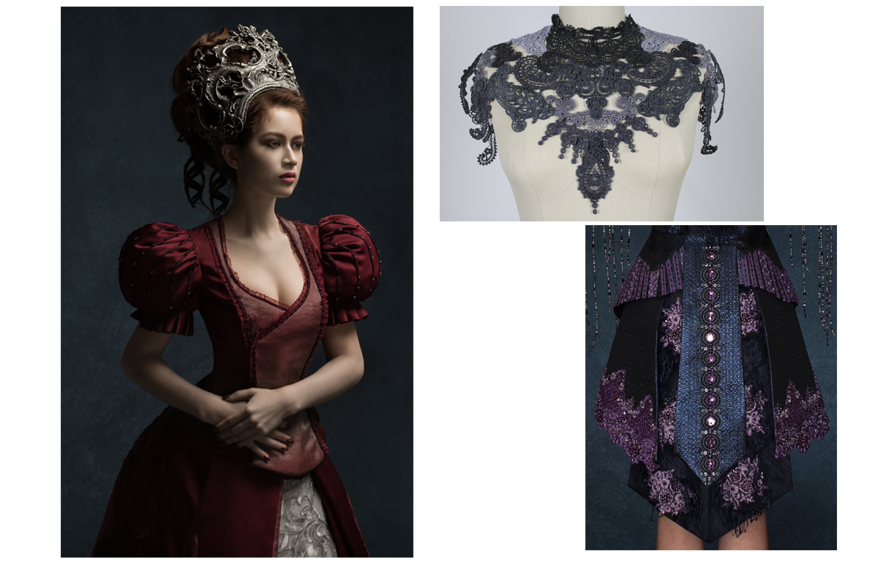
HISTORY & SOCIAL CONTEXT
FASHION HISTORY
EVOLUTION OF CLOTHING
FASHION & TREND CYCLES
CULTURAL-SOCIAL INFLUENCES
Jeanne Roiter 2018
AMAZON – TECHNICAL DESIGN

Slide 15

AD&D CURRICLUM CAPSTONE
JOIN US FOR OUR
FASHION PORTFOLIO SHOWCASE
To protect our community, we will be hosting our event remotely this year.
More details to come! Check our website for more information soon.
JUNE 17, 2021
http://schoolofappareldesignanddevelopment.com

Slide 16


http://schoolofappareldesignanddevelopment.com

Slide 17
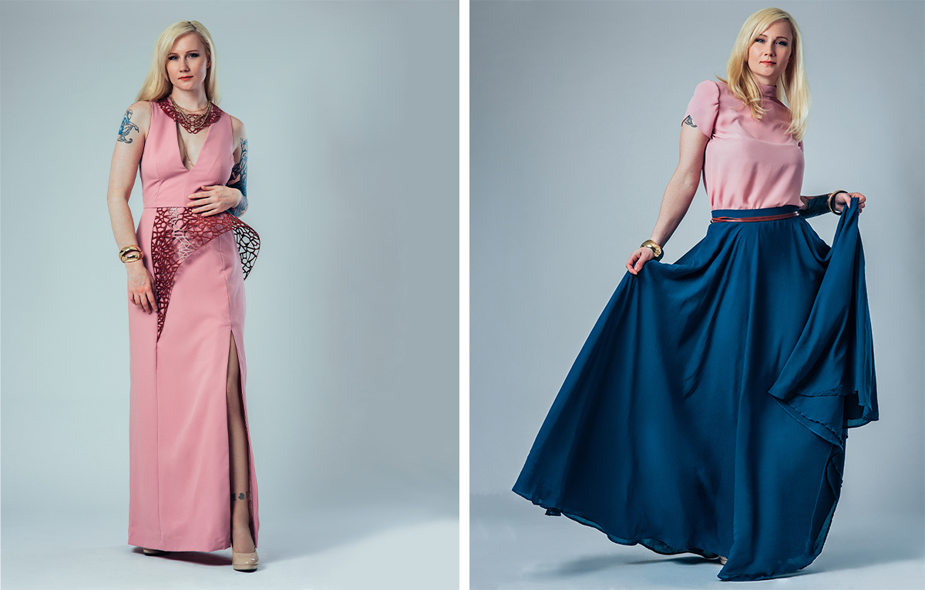
Our graduates get hired
The school enjoys strong partnerships with apparel companies —in the northwest, nationally and internationally. Many of our alumni have risen as top leaders in our industry. Employers rely on the School of Apparel Design & Development for employees who bring relevant skills to their companies.
HIRING RATES
2015 / 96%
2016 / 100%
2017 / 98%
2018 / 100%
2019 / 75%
(2019 - high proportion of independent designers)
PAY RATES
$40-50,000 annually with significant increase over 5 years.
Megan Dellario 2018

Slide 18
Prairie Underground
Puma
Quick Silver
Rainy Pass Repair
Ralph Lauren
Reebok
REI
Report Footwear
Royal Robin
Scott USA
Seattle Children’s Theater
Seattle Opera
Seattle Repertory Theater
Shah Safari
Spacecraft
Tabar, Inc.
The Gap
The Men’s Wearhouse
The Rafaella Group
Tira
Thom Browne
Tommy Bahama
Union Bay
USA Grown Up Group
Utilikilts
Village Theatre
Woolrich
YoungOne
Zumiez
5th Avenue Theatre
Actual Pain
A|X Armani Exchange
Adidas
Ann Taylor
Atelier Verdigris
Autumn Cashmere
Bath and Body Works
Bella Materna
Belles Down
Brooks Sports
Bunnies by the Bay
Calvin Klein
Carry Gear Solutions
CC Filson
Cicada
Cirque du Soleil
Classic Accessories
Columbia Sportswear
Crave Apparel
Cutter and Buck
DKNY
Dream Out Loud by Selena Gomez
Eddie Bauer
Fashion Avenue Knits
FibreArts, Inc.
Fortune Swimwear/Charlie Jade
French Connection
Furla
G-III/Guess
G.H. Bass
Greg Thompson Productions
Henri and Flora
International News
Intiman Theatre
Jag Jeans
J. Crew
JC Penney
Kaufman-Davis Studio
Lands End
Levi’s
Liz Claiborne
Lizzie Parker
LL Bean
Lucky Brand Jeans
Narciso Rodriguez
Neiman Marcus
Nike
Nordstrom
Oak NYC
Outdoor Research
Pacific NW Ballet
Patagonia
Period Corsets
Perry Ellis
WHERE DO ALUMNI WORK?

Slide 19

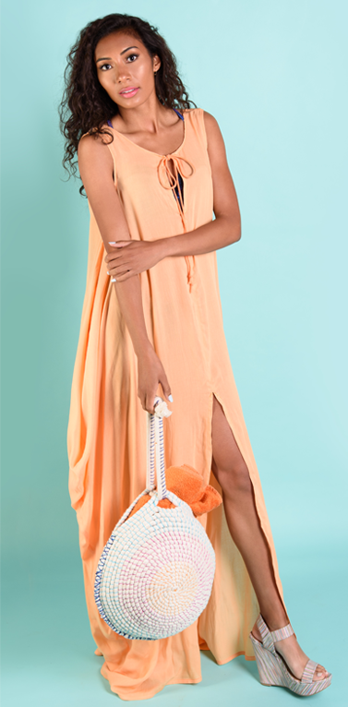



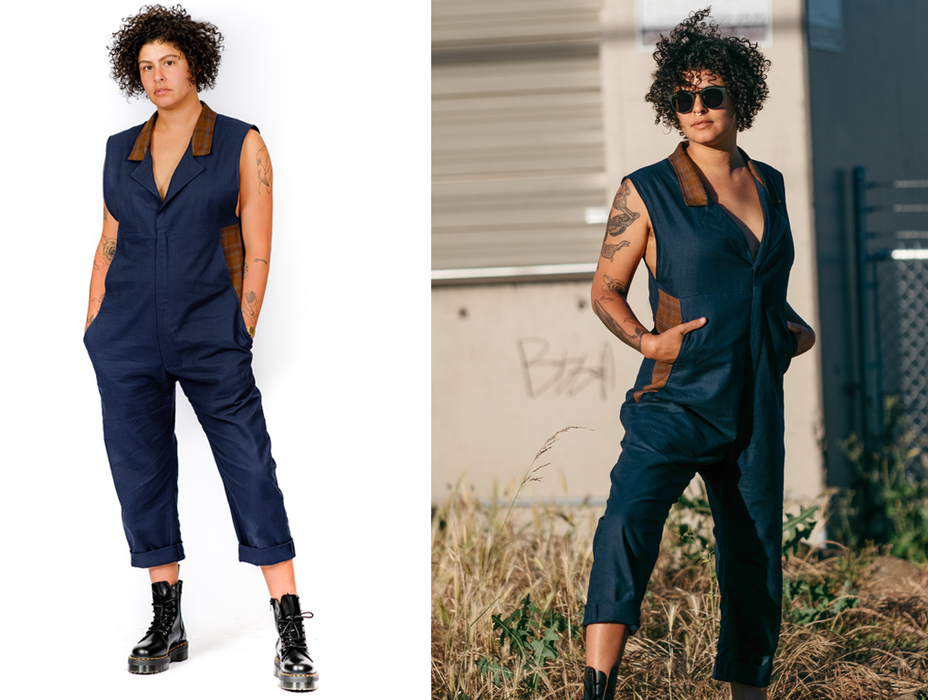

GRADUATE PORTFOLIOS
ATARAH SPEARS / 2017 / ASSISTANT DESIGNER - ZUMIEz
ALEX SNELL / 2018 / ASSISTANT DESIGNER HANDBAGS - NORDSTROM
AKROFI ADJUMANI / 2018 / FIT SPECIALIST – NORDSTROM / OWNER – AKROFI ADJUMANI
GENEVIEVE GREEN / 2017 / STYLIST - ZULILY
SIOBHAN TEAHAN / 2019 / OWNER – NEW AFFECTION
CLAIRE JOKO-FUJIMOTO / 2019 / ASSISTANT – PUPPETS & PUPPETS nyc

Slide 20
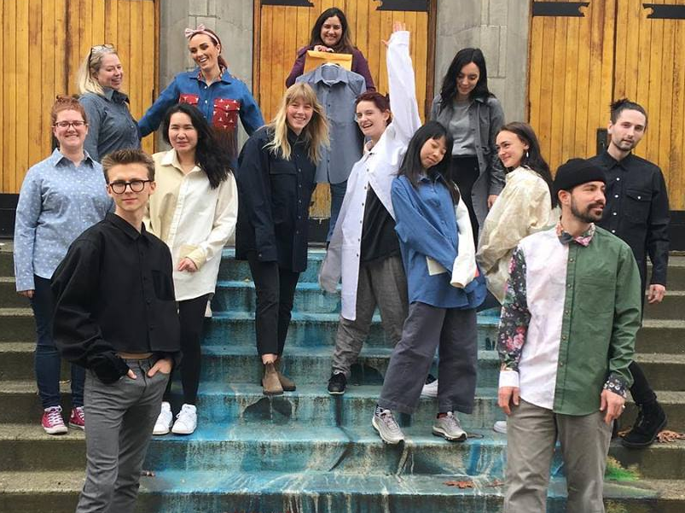
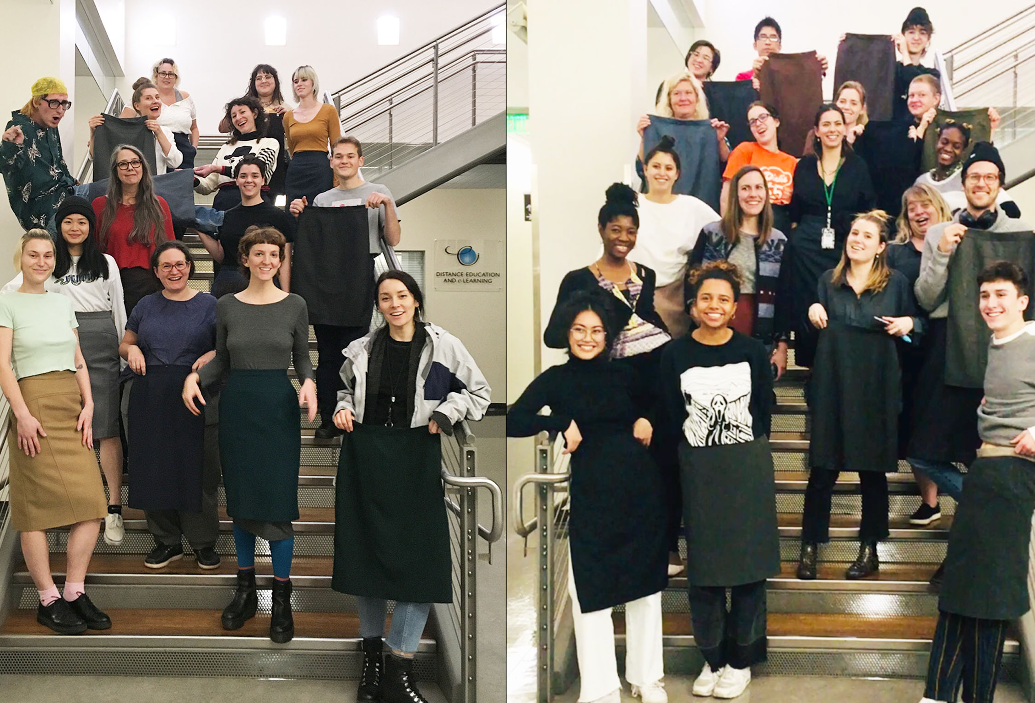
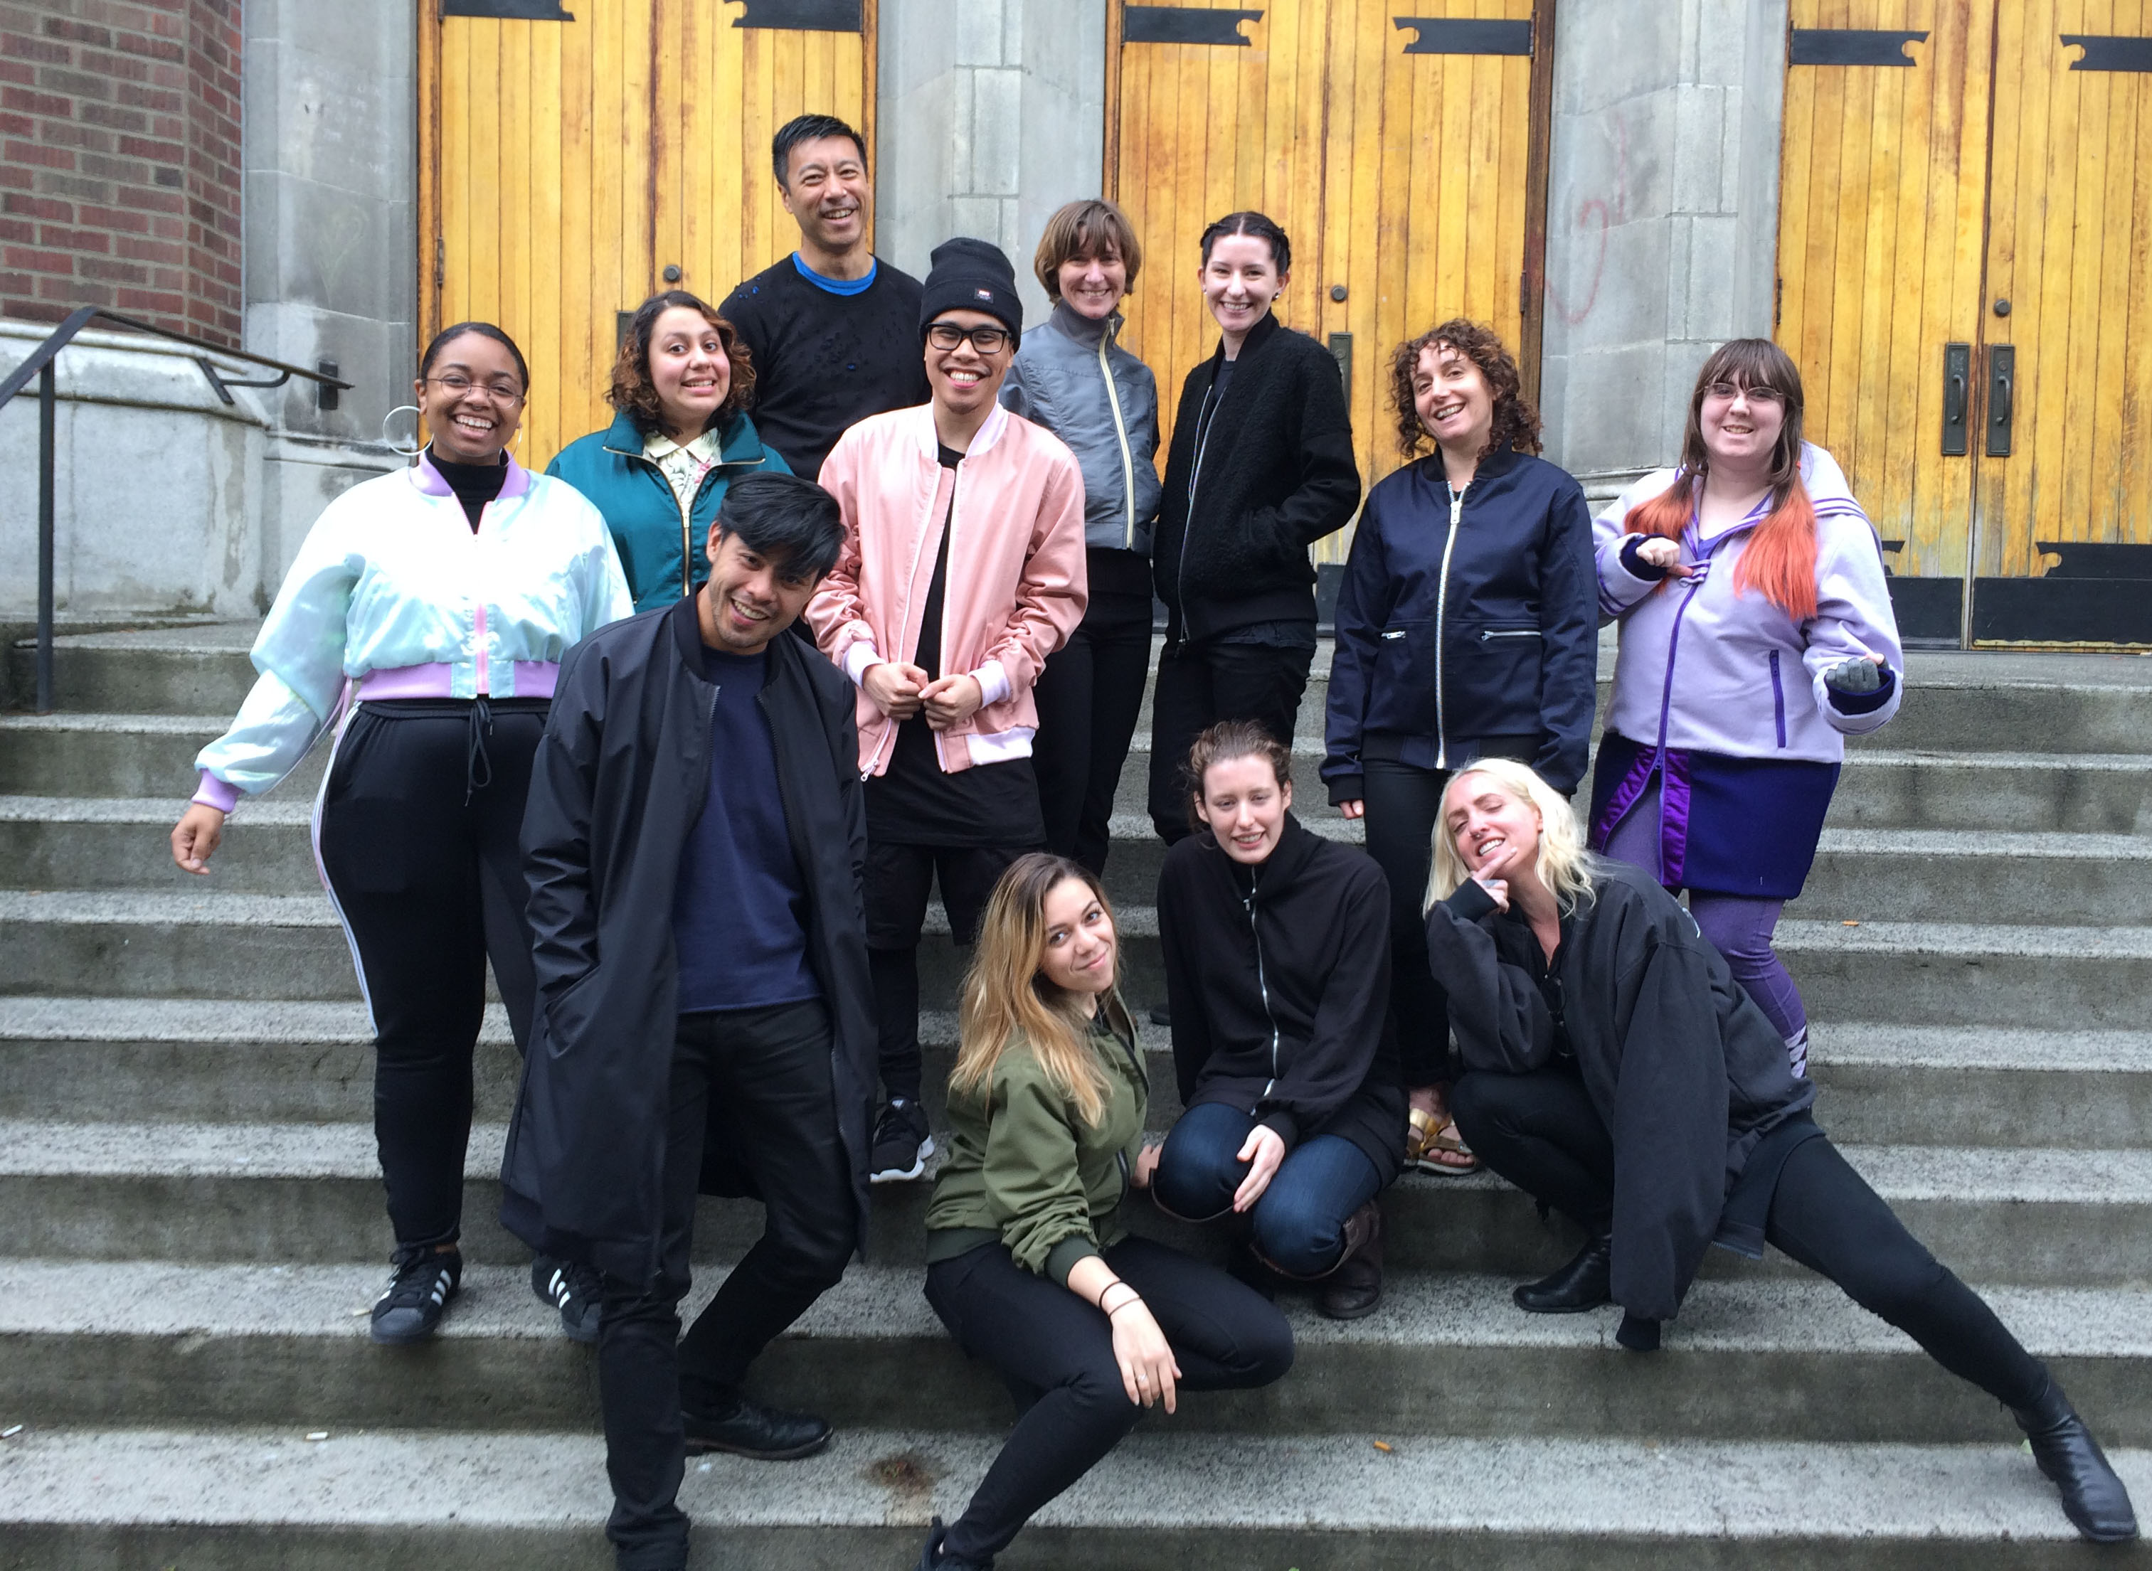
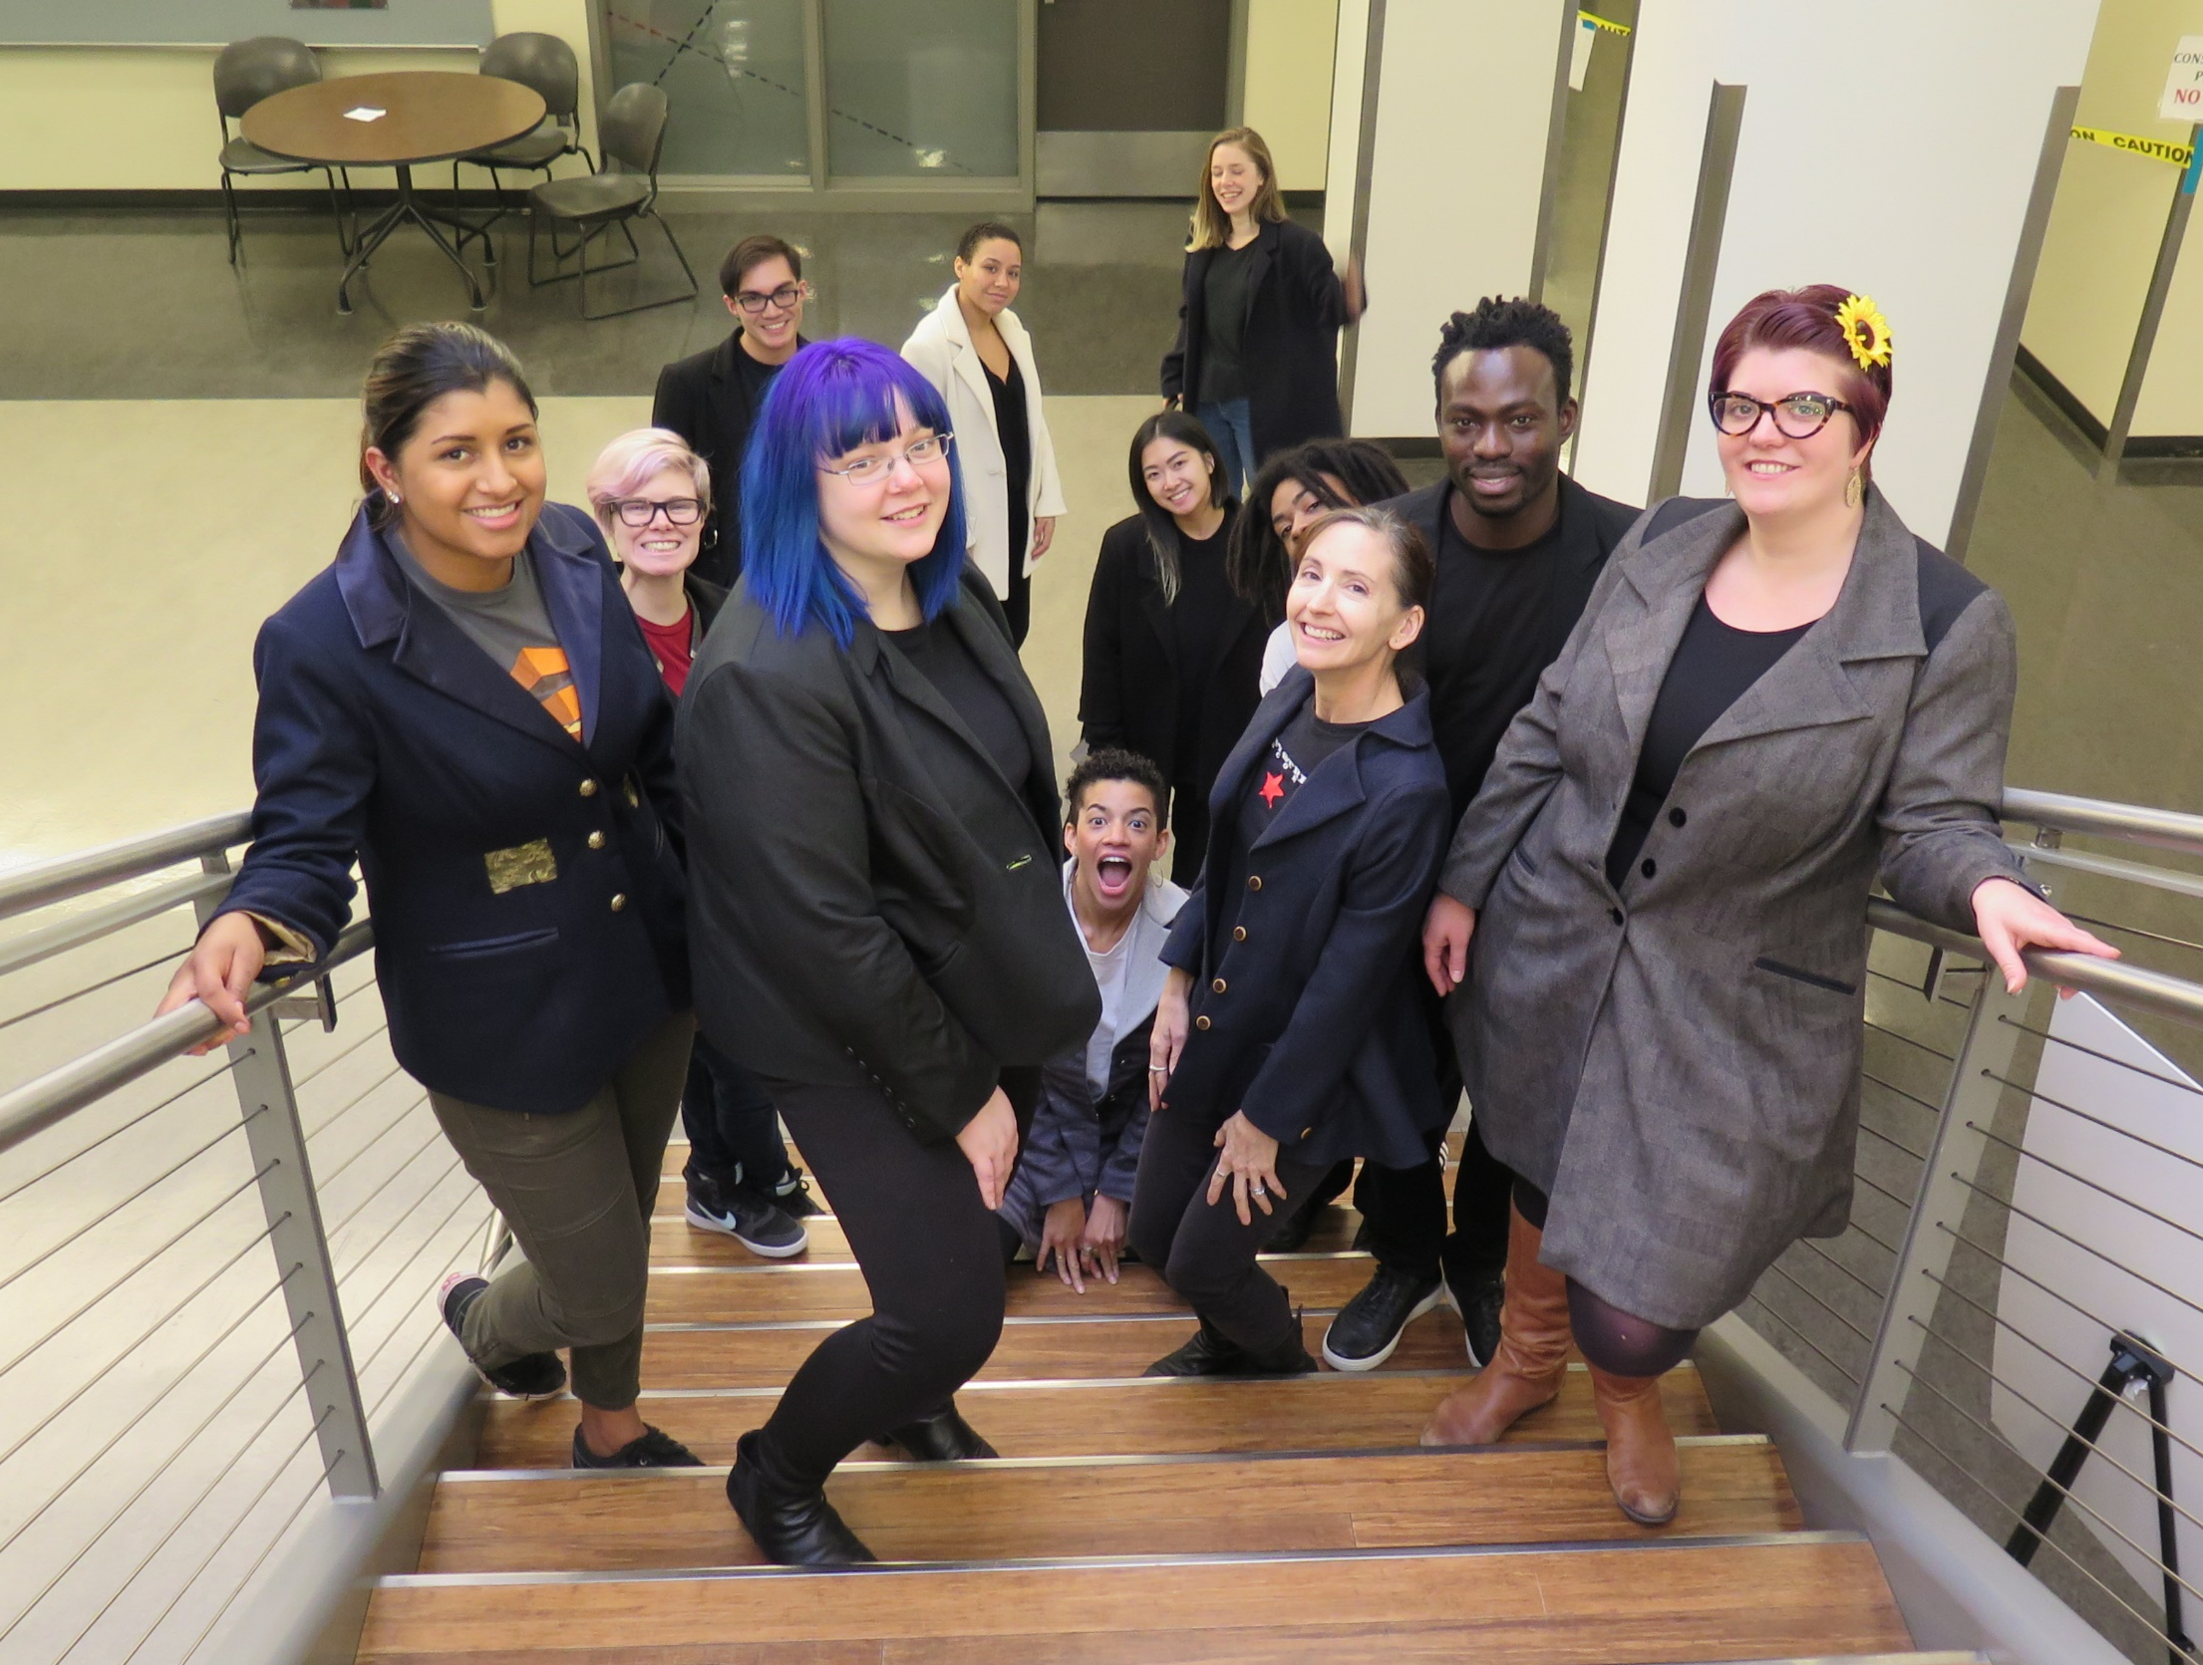
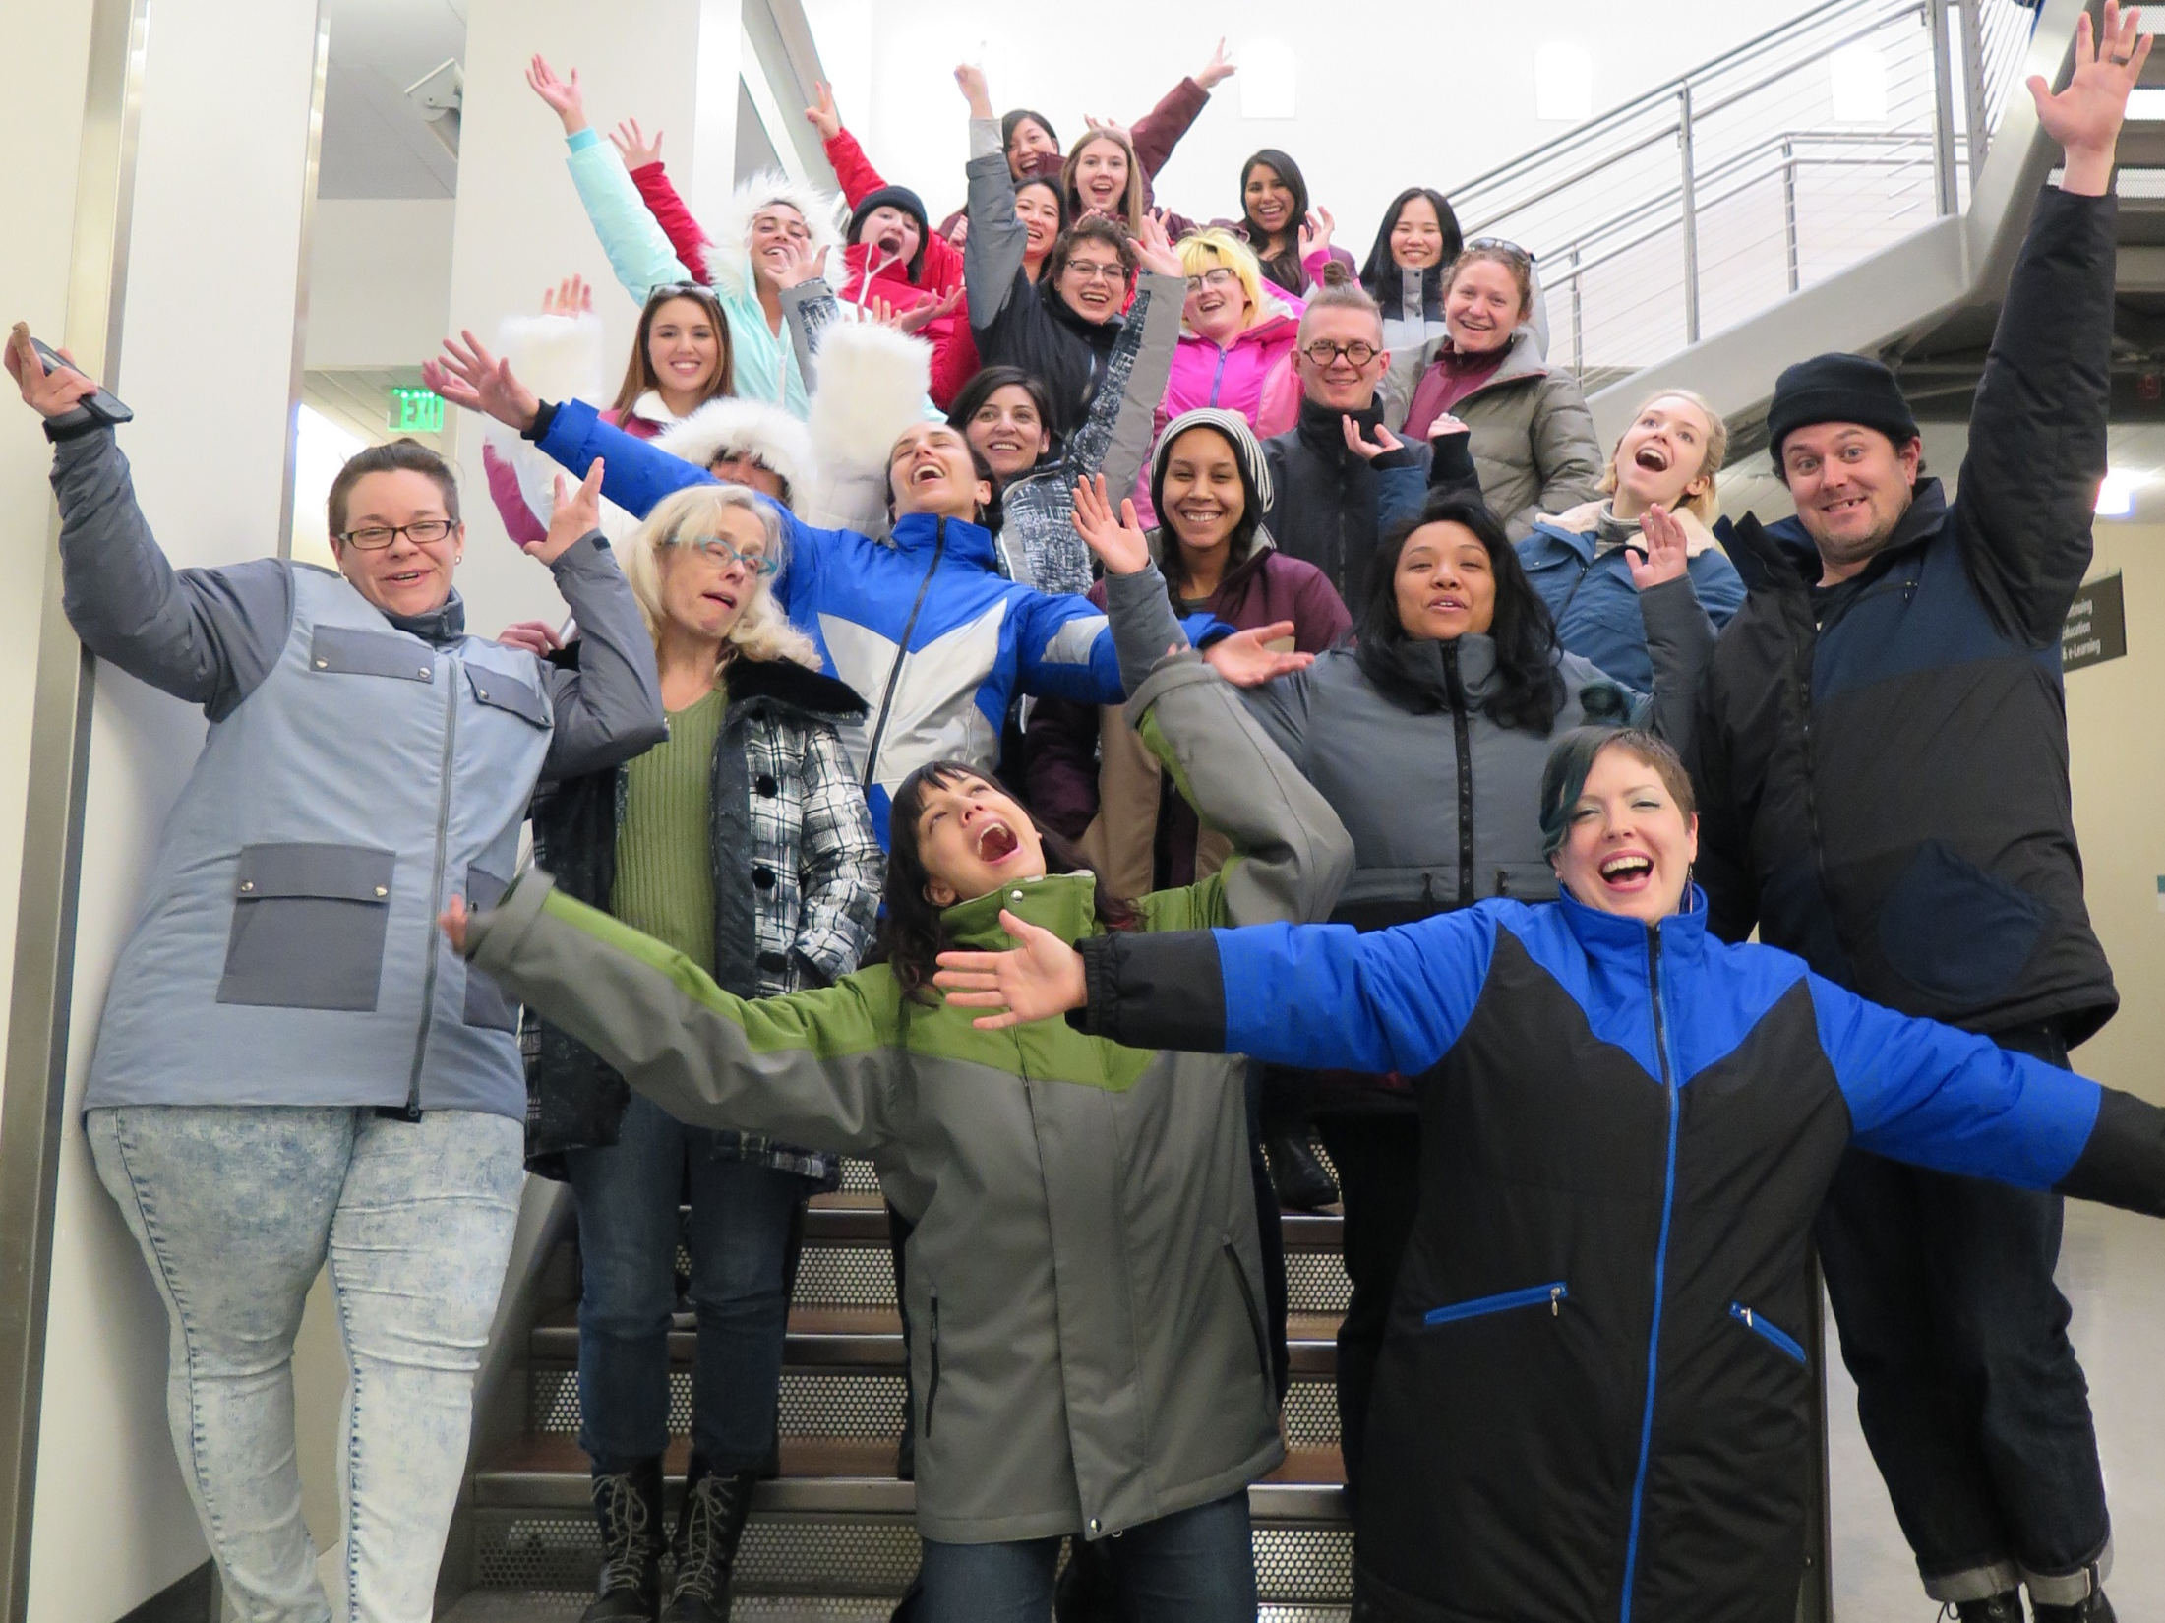
STUDENT PROJECTS
straight skirts / first year / 2019
button down shirts with collar / first year / 2018
tailored jackets / second year / 2018
bomber jackets / first year / 2017
outerwear – ski jackets / second year / 2016

Slide 21
SCHOOL OF APPAREL DESIGN & DEVELOPMENT
Tuition costs
TUITION RATES PER CREDIT:
Resident - $110.26
Non-Resident - $124.85
International - $288.13
Tuition rates fluctuate per quarter. Check the SCC website for updates.
AD&D QUARTERLY COST ESTIMATES:
12-19 credit quarters range from $1,200 - $2,050 (resident price)
ONE-TIME SUPPLY KIT COSTS:
Skill Development course kit - $45 ($55 for summer intensive APPRL 099)
Full Time course kits:
Art supply kit - $150
Sewing kit - $300
Books - $100 - $300
FINANCIAL AID
Financial aid and student loans available. See Financial aid offices for details.

Slide 22
SCHOOL OF APPAREL DESIGN & DEVELOPMENT
GET STARTED!
Admittance to the AD&D program is once a year each Fall.
Enroll in APPRL 099 – Summer Intensive This track is best for those who have previous knowledge and experience with sewing techniques and strong time management skills. This intensive course is 5 hours 3 days per week for 8 weeks. You will need to plan additional time to complete homework, an average of 30 hours per week. It will allow you to accomplish the Skill Development sequence in one quarter and is an alternative to the 096/098/100 series. It is highly suggested that you get the English, Math, and Computer requirements done before you enroll in this course. Enrollment opens May 24.
Enroll in APPRL 096/098/100 – Pre-Requisite series Taking this series in sequence over 3 quarters is the recommended path to the full-time program. Beginning with 096 in the Fall quarter will give you ample time to re-take a course if needed, accomplish all your requirements, plan your finances, and get fully prepared before entering the program.

Slide 23
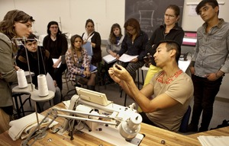
SCHOOL OF APPAREL DESIGN & DEVELOPMENT
QUESTIONS?
Program Instructional Assistant: Rebecca Johnston Rebecca.Johnston@seattlecolleges.edu 206-934-3223
Advisor: Tess Griswold
Tess.Griswold@seattlecolleges.edu 206-934-2052

Slide 24
SCHOOL OF APPAREL DESIGN & DEVELOPMENT
What is the typical schedule?
Do students often also balance work with school?
Do students need any equipment or materials? What are the costs for these?
What type of faculty are teaching in this program?
You will get more information on admissions and advising in the 4:30-5pm session.

Slide 25

Return to Main Session
(select “Leave Breakout Room” to return)

Slide 26
SCHOOL OF APPAREL DESIGN & DEVELOPMENT
WHICH PATH IS THE RIGHT CHOICE FOR ME?
APPRL 096/098/100 – Sequence series Taking this series in sequence over 3 quarters is the recommended path to the full-time program. Beginning with 096 in the Fall quarter will give you ample time to re-take a course if needed, accomplish all your requirements, plan your finances, and get fully prepared before entering the program.
APPRL 099 – Summer Intensive This track is best for those who have previous knowledge and experience with sewing techniques and strong time management skills. This intensive course is 5 hours 3 days per week for 8 weeks. You will need to plan additional time to complete homework, an average of 30 hours per week. It will allow you to accomplish the Skill Development sequence in one quarter and is an alternative to the 096/098/100 series. It is highly suggested that you get the English, Math, and Computer requirements done before you enroll in this course.

Slide 27
SCHOOL OF APPAREL DESIGN & DEVELOPMENT
LET’S TALK ENROLLMENT…
Admittance to the AD&D program is once a year each Fall.
To enroll in the School of Apparel Design & Development at SCC, you must complete the following steps to be placed on the program admissions list.
Step 1 / admission to SCC
Admission can be completed in person in room 1104-B1 or online by going to seattlecentral.org/admissions/.
Acceptance to Seattle Central College does not guarantee entrance into AD&D. To ensure the application process is complete, you must follow each step to be on the approved list for Fall enrollment.

Slide 28
SCHOOL OF APPAREL DESIGN & DEVELOPMENT
Step 2 / Academic Requirements
Students must show that they are ready to take College Composition (English 101) and Algebra (MAT 084) by either taking the WBST and ALEKS placement tests or providing transcripts from any previously attended accredited institution. Information on admissions testing is on the Seattle Central College website.
English Placement Test – WBST (Wonderlic)
Testing ONLINE in room 1106. No appointment is necessary. The test takes 20 minutes. Bring Photo ID and $20.00 testing fee. You can attempt this test 2 times.
Math Placement Test – ALEKS
Testing ONLINE or in room 1106. You are allowed up to three hours at the testing center. The test fee is $15.00. You can attempt this test up to 4 times.
Computer Requirement Test – SAM Challenge
Testing is conducted in room 1106. Allow at least 2 hours for testing. Must be done in one session. Testing fee is $35. There is no wait time for Apparel Students to retake. Passing score is 40/50. During remote operations, this test is currently on hold. Further details to come.
Transcripts
Obtain a copy of any previous college transcripts and continue to the next step. Submit these to admissions and advising. Math scores are only good for 3 years. After that, you will need to take the math placement test.

Slide 29
SCHOOL OF APPAREL DESIGN & DEVELOPMENT
Step 3 / Advising
Once you have been admitted to Seattle Central and have evidence of academic eligibility either with English and Math placement test scores or transcripts, email your Workforce Education Counselor.
Tess Griswold: Tess.Griswold@seattlecolleges.edu / 206-934-2052
What to send:
Student ID number
Send a copy of your transcript or let them know you have completed ENGLISH & MATH testing
Ask to be put on the admissions list for AD&D
Please send transcripts to ADMISSIONS first. ADVISING will then check them for your ENGLISH & MATH requirement.
During remote operations, testing for requirements for ENGLISH & MATH will be held online.

Slide 30
SCHOOL OF APPAREL DESIGN & DEVELOPMENT
Step 4 / required skills
Students wishing to enter AD&D must also demonstrate intermediate sewing skills.
Intermediate sewing skills can be demonstrated by completing our Skill Development Series, APPRL 096, 098, and 100. Those wishing to go directly into APPRL 100 must have previous experience with industrial equipment and construction techniques. The test out can be arranged by contacting Rebecca Johnston by email to schedule a test date. A minimum of 1 year of experience is recommended to attempt the test out option.
Testing out is not available until the campus is open to the public.
Please email Rebecca with further inquiries.
SKILL DEVELOPMENT CLASS SCHEDULE
FALL: APPRL 096
WINTER: APPRL 096, APPRL 098
SPRING: APPRL 098 & APPRL 100
SUMMER: APPRL 100 & APPRL 099 (Summer Intensive)

Slide 31
SCHOOL OF APPAREL DESIGN & DEVELOPMENT
Step 4 / required skills
WHICH PATH IS THE RIGHT CHOICE FOR ME?
APPRL 096/098/100 – Sequence series Taking this series in sequence over 3 quarters is the recommended path to the full-time program. Beginning with 096 in the Fall quarter will give you ample time to re-take a course if needed, accomplish all your requirements, plan your finances, and get fully prepared before entering the program.
APPRL 099 – Summer Intensive This track is best for those who have previous knowledge and experience with sewing techniques and strong time management skills. This intensive course will allow you to accomplish the Skill Development sequence in one quarter and is an alternative to the 096/098/100 series. APPRL 099 must be completed in 8 weeks over summer. Each class is 5 hours and held 3 days a week. It is highly suggested that you get the English, Math, and Computer requirements done before you enroll in this course. It is not recommended that you take other courses while enrolled in APPRL 099. The workload is intensive, the pace is very rigorous, and you will need to access the lab outside of class times. Please prepare to give this course your full attention. This will guarantee you greater success in the completion of this intensive and exciting fast-track course.

Slide 32
SCHOOL OF APPAREL DESIGN & DEVELOPMENT
You’ve been Approved!
KEEP IN CONTACT WITH THE AHSS OFFICE
Once ADVISING has put you on the list for AD&D, your information will be tracked in the Arts, Humanities, & Social Sciences department office.
EMAIL SEMHAR – PROGRAM SUPERVISOR / AHSS
Semhar Tekeste: semhar.Tekeste@seattlecolleges.edu
Please inform the AHSS once you have completed all the requirements. This includes, ENG, MATH, & Computers as well as all your APPRL pre-requisites.
Once all are marked as complete, you will receive your registration information via e-mail. Emails sent out the end of Spring and Summer quarters.
Once all the enrollment steps are completed, you will be placed on the APPROVED LIST! Check your email for enrollment information and next steps.
ORIENTATION
There will be a required orientation a week before classes, so keep your calendars open.

Slide 33
SCHOOL OF APPAREL DESIGN & DEVELOPMENT
Tuition costs
TUITION RATES PER CREDIT:
Resident - $110.26
Non-Resident - $124.85
International - $288.13
Tuition rates fluctuate per quarter. Check the SCC website for updates.
AD&D QUARTERLY COST ESTIMATES:
12-19 credit quarters range from $1,200 - $2,050 (resident price)
ONE-TIME SUPPLY KIT COSTS:
Skill Development course kit - $45 ($55 for summer intensive APPRL 099)
Full Time course kits:
Art supply kit - $150
Sewing kit - $300
Books - $100 - $300
FINANCIAL AID
Financial aid and student loans available. See Financial aid offices for details.

Slide 34
SCHOOL OF APPAREL DESIGN & DEVELOPMENT
Enrollment review
Enrollment in the full-time program is once a year each Fall. It is a six-quarter curriculum with off time in the summer.
Classes are typically held five days a week. There are currently no part-time options available so plan your schedules ahead of time.
Skill Development beginner course, APPRL 096, is offered in Fall and Winter quarters only.
Skill Development classes fill up fast! Check on the SCC website for registration dates and information.
All placement tests and Skill Development courses must be complete in order to enroll in the program. Visit https://www.khanacademy.org/ for study guides for English and Math.
Make sure to meet with Advising right away to assess your entry level and get put on the admissions list for AD&D.
There is a required 250-hour internship to complete over summer break. Adding this experience to your resume will create a seamless transition from school to the industry!

Slide 35



SCHOOL OF APPAREL DESIGN & DEVELOPMENT
Preparing for AD&D: tips & tricks
Make sure to plan ahead when deciding on if the program is right for you. It takes a huge time commitment and is also mentally and physically strenuous. It’s not something to rush into, which is why we have our Skill Development Series to help get you acclimated.
Get your English, math, and computer requirements done early! The sooner you get those completed the easier your Skill Development journey will go. Make sure to meet with the Advising Department right away to ensure you are on the list for AD&D and have met all the requirements. Don’t wait until the last minute or you may be at risk of not being able to enroll in time for Fall.
It’s never too early to start your financial planning. We recommend keeping outside work to approximately 10 hours a week to maintain the workload of the program. Start saving for school ahead of time and remember to talk with the Financial Aid Department. They can help you apply for student funding and can guide you through the process. There are scholarships available! Look for applications on seattlecentral.edu starting Feb. 15th. Submit your FAFSA early to receive the maximum assistance possible.

Slide 36



SCHOOL OF APPAREL DESIGN & DEVELOPMENT
Preparing for AD&D: tips & tricks
Prepare your home space ahead of time. You’ll be able to manage your time best if you have a productive area to do your construction and patternmaking homework. Although not required, it can be helpful to purchase an industrial sewing machine and a table for patternmaking. Subscribing to the Adobe Suite at home will make your computer course homework a breeze. Student discounts available!
Deadlines are super important in your course load, so being on top of your schedule will be key to your success. Plan to accommodate for commuting, childcare, outside work, and personal time. Having a calendar or personal planner can help you organize and remember how to juggle your time wisely.
Once in the program you’ll be super busy, and it will be easy to forget about your personal needs. Factor in ways of getting the self-care you deserve. Having a support network and taking care of your mental and physical health will keep you going during those stressful times. Counseling and other support services available. Start practicing these habits early to keep you happy and healthy throughout your AD&D journey.

Slide 37

SPECIAL THANKS TO ALL OUR FACULTY,
STAFF, ALUMNI, & STUDENTS.
Tanya Knannlein / Lead Coordinator / Instructor
Scott Moy / Coordinator / Instructor
Ondine Toler-Scott / Instructor
Emily Quilter / Instructor
Dawn Smithson / Instructor
Leah Watkins / Instructor
Aumelina Delasiete / Instructor
Charlie D’Amato / Instructor
Loucinda White / Instructor
Rebecca Johnston / Instructional Technician
Semhar Tekeste / Program Specialist / AHSS
Tess Griswold / Workforce Ed. Counselor / Advising
Arts, Humanities & Social Sciences
Seattle Central College
Music by Gravy Beats
VISIT OUR WEBSITE
schoolofappareldesignanddevelopment.com
Thank you for viewing
Dan Mclean 2019

